Slide 1
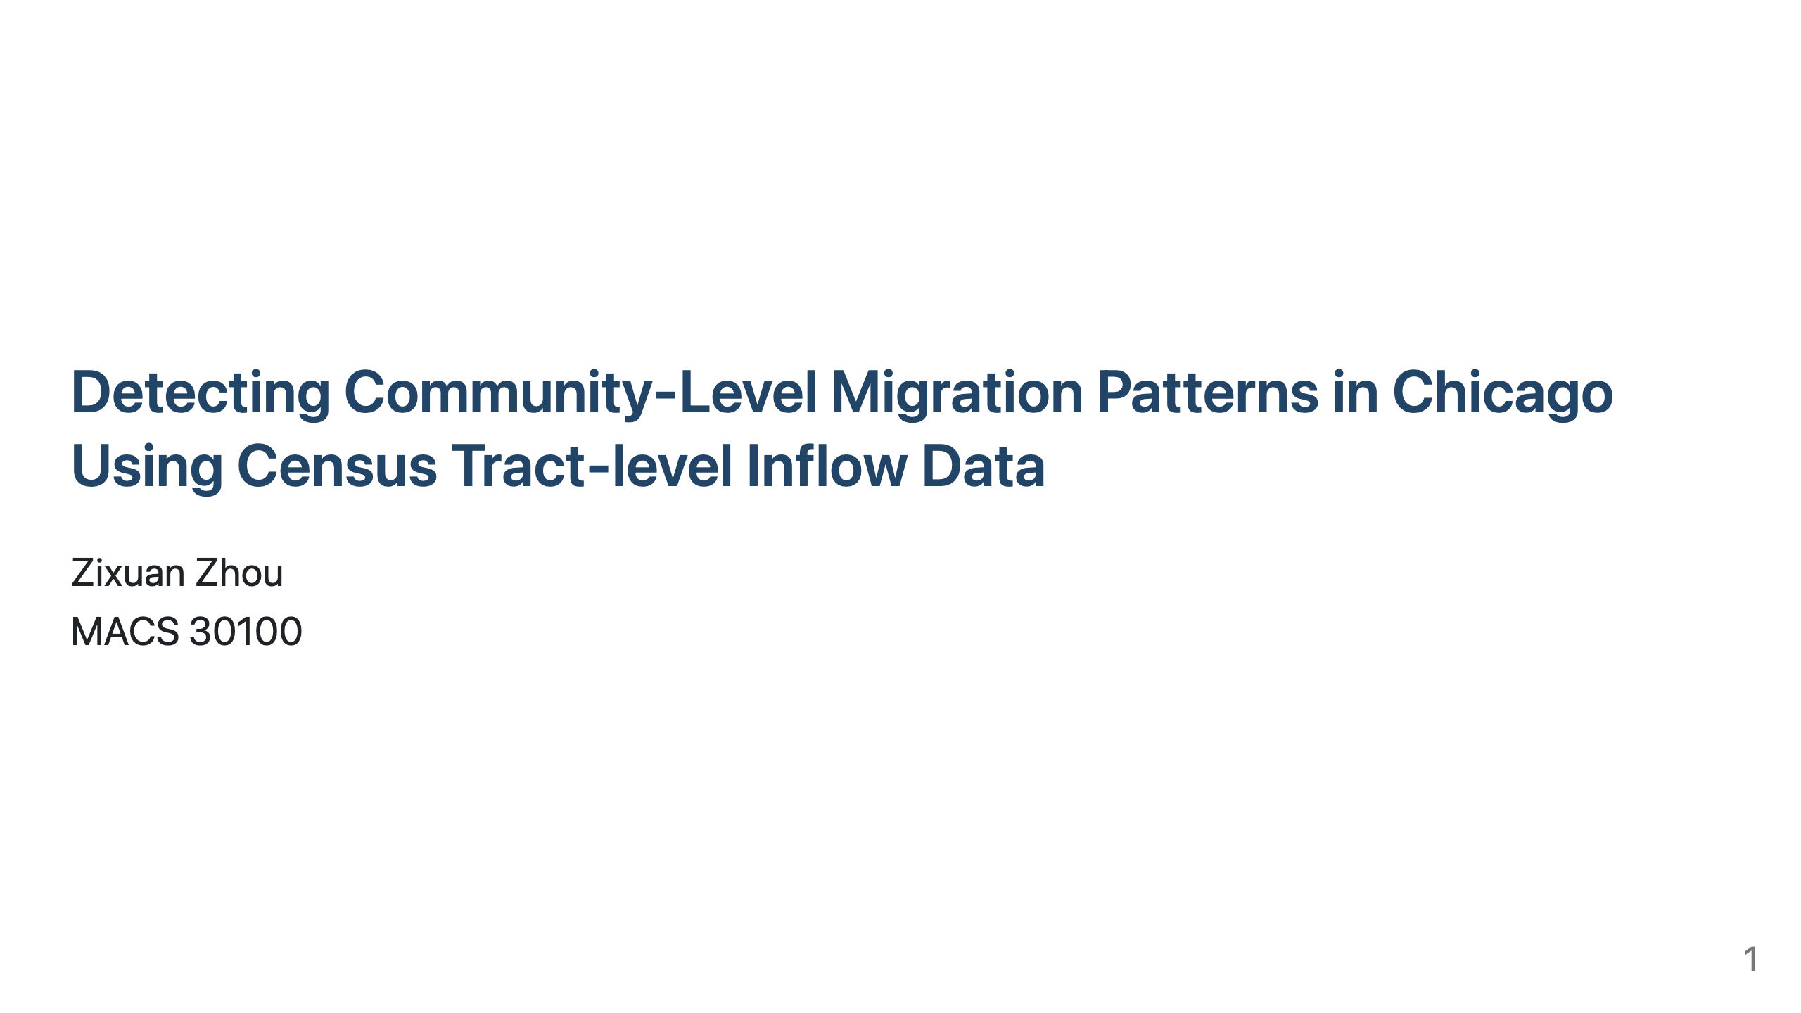
Notes:
Hi everyone. I'm excited to share my research on detecting neighborhood inflow migration patterns in Chicago and predicting these trends using socio-economic factors.

Slide 2
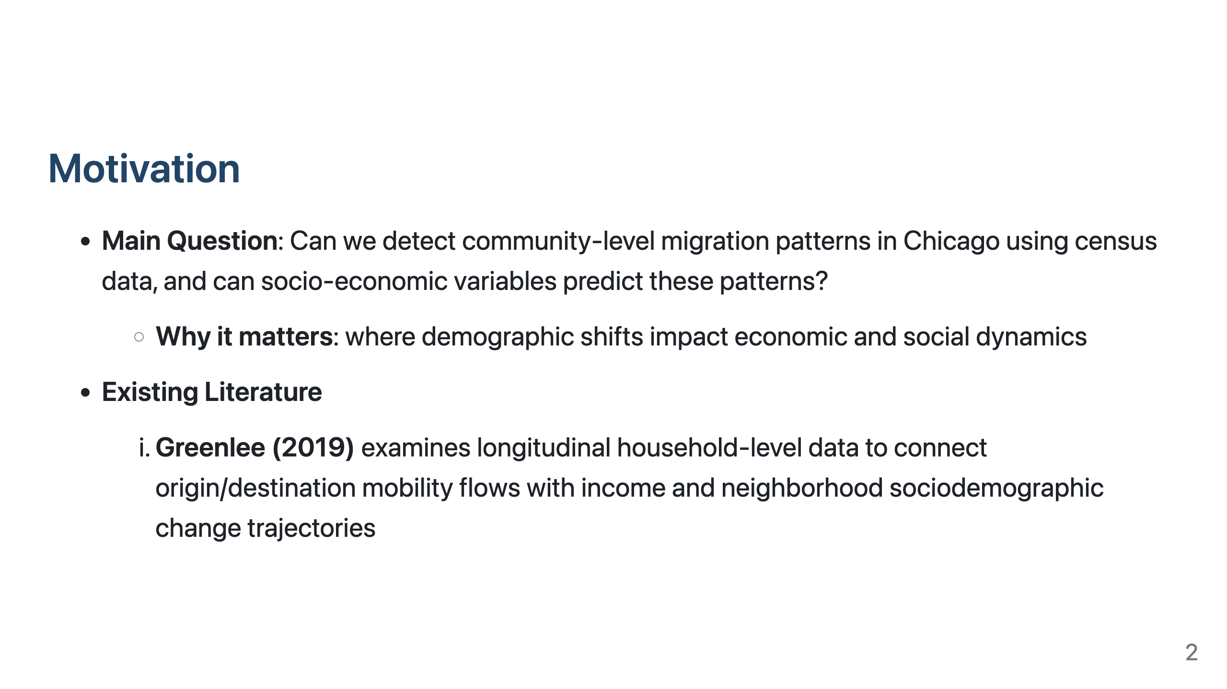
Notes:
Migration patterns significantly impact neighborhoods' economic and social dynamics. My main question is whether we can identify distinct community-level inflow migration patterns in Chicago using census data, and if socioeconomic variables can predict these patterns.

Slide 3
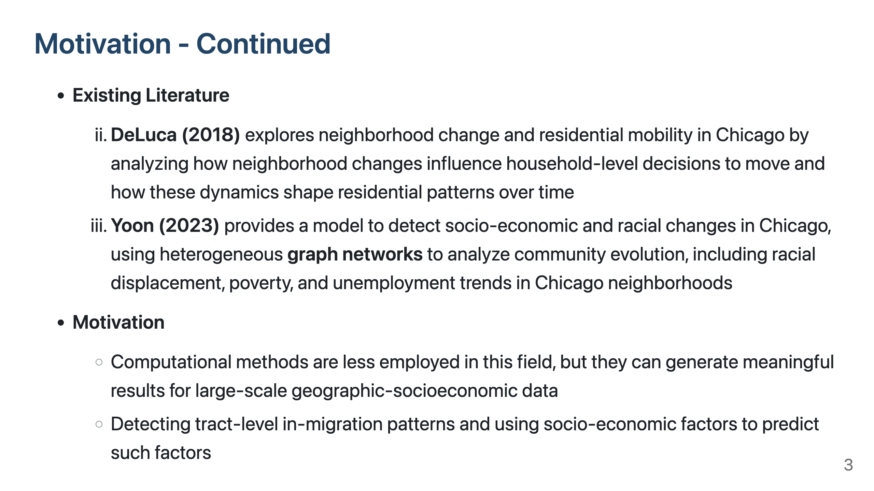
Notes:
Some highlights in previous research in this area includes Greenlee's 2018 study connecting mobility flows with neighborhood change, and Yoon's 2023 model analyzing socioeconomic changes using graph networks. I've taken a computational approach to this question, which is relatively underutilized in this field but valuable for large-scale geographic and socioeconomic data analysis.

Slide 4
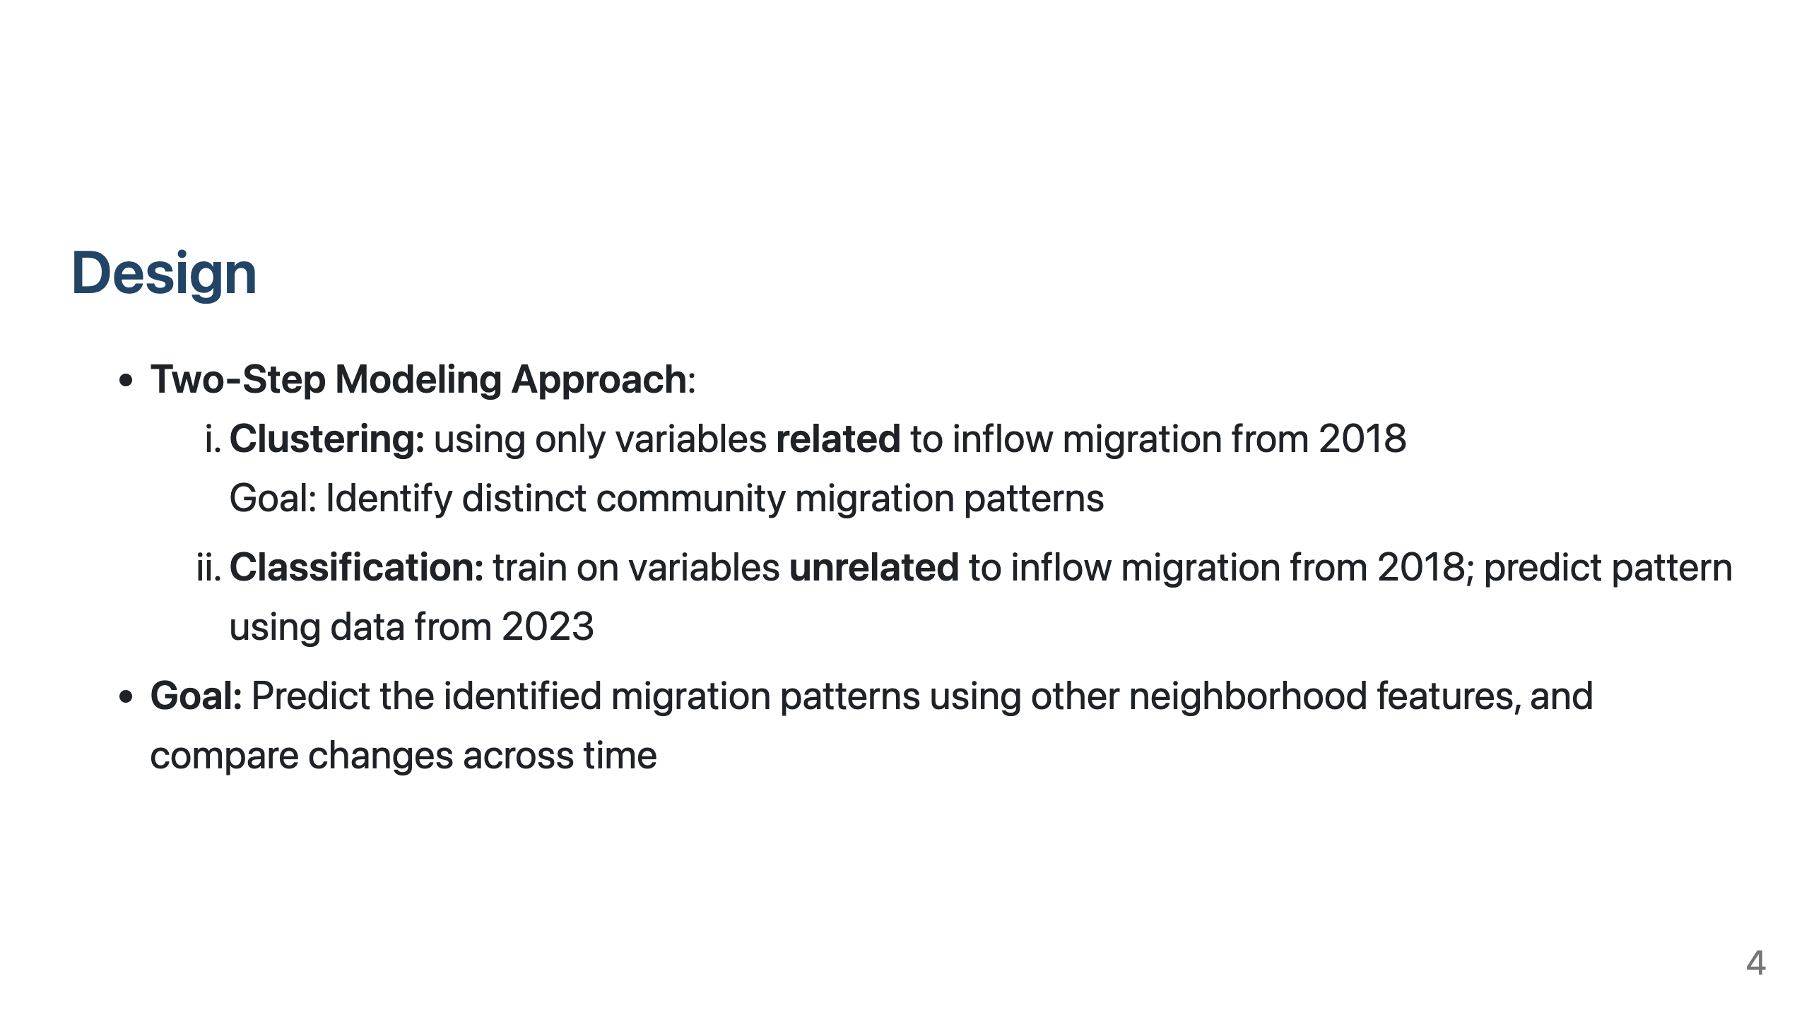
Notes:
I used a two-step modeling approach:
Clustering on inflow migration variables from 2018 to identify distinct community patterns
Training classification models on other neighborhood features to predict these patterns using 2023 data (model trained on 2018 data; prediction using 2023 data)
This approach allows us to both identify natural patterns and examine how other factors predict them over time.

Slide 5
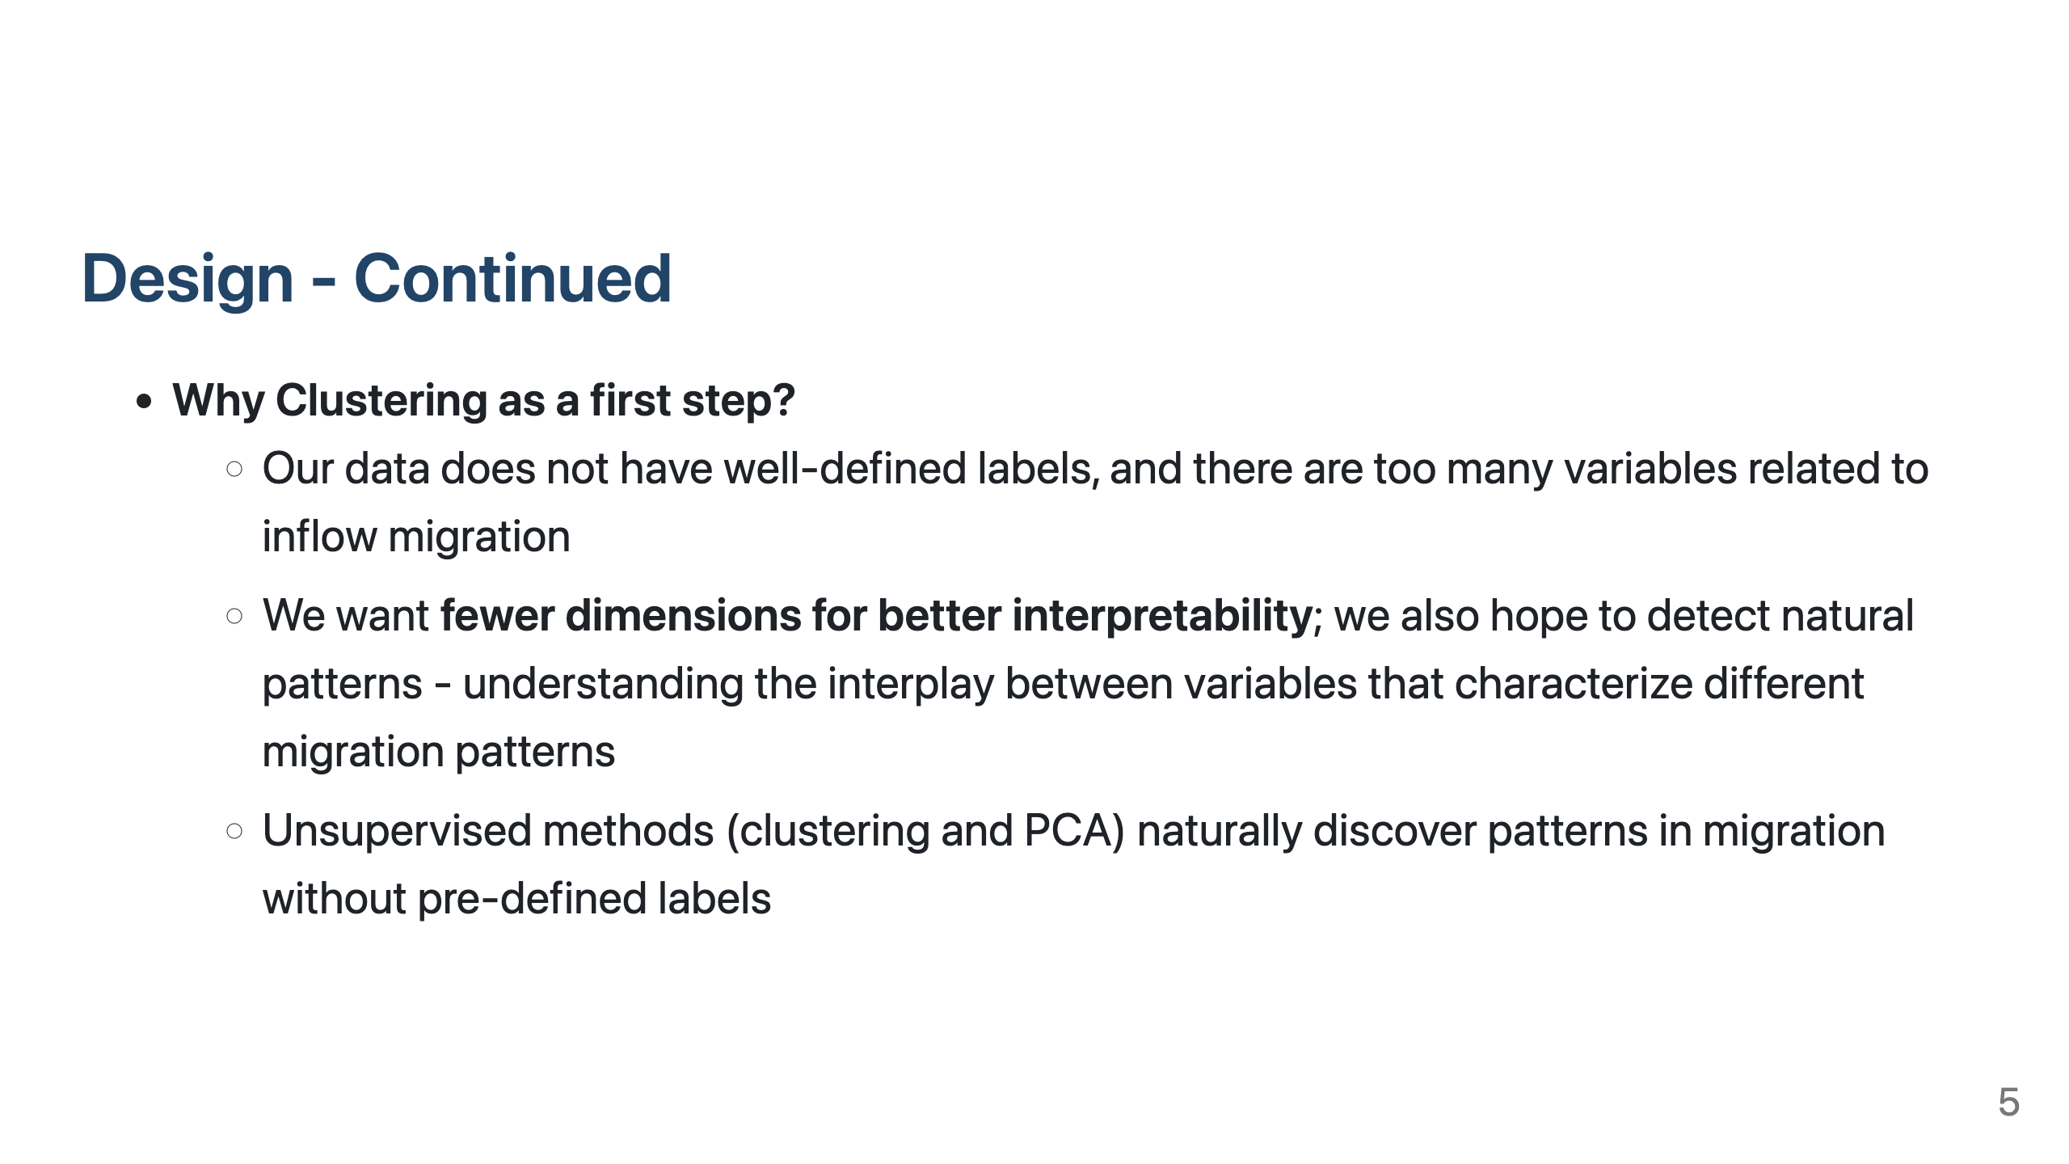
Notes:
The reason I used clustering as a first step is because there are no clearly defined labels for our data, and there are too many variables related to inflow migration. We want to only keep a few dimensions for better interpretability, and detecting natural patterns.

Slide 6
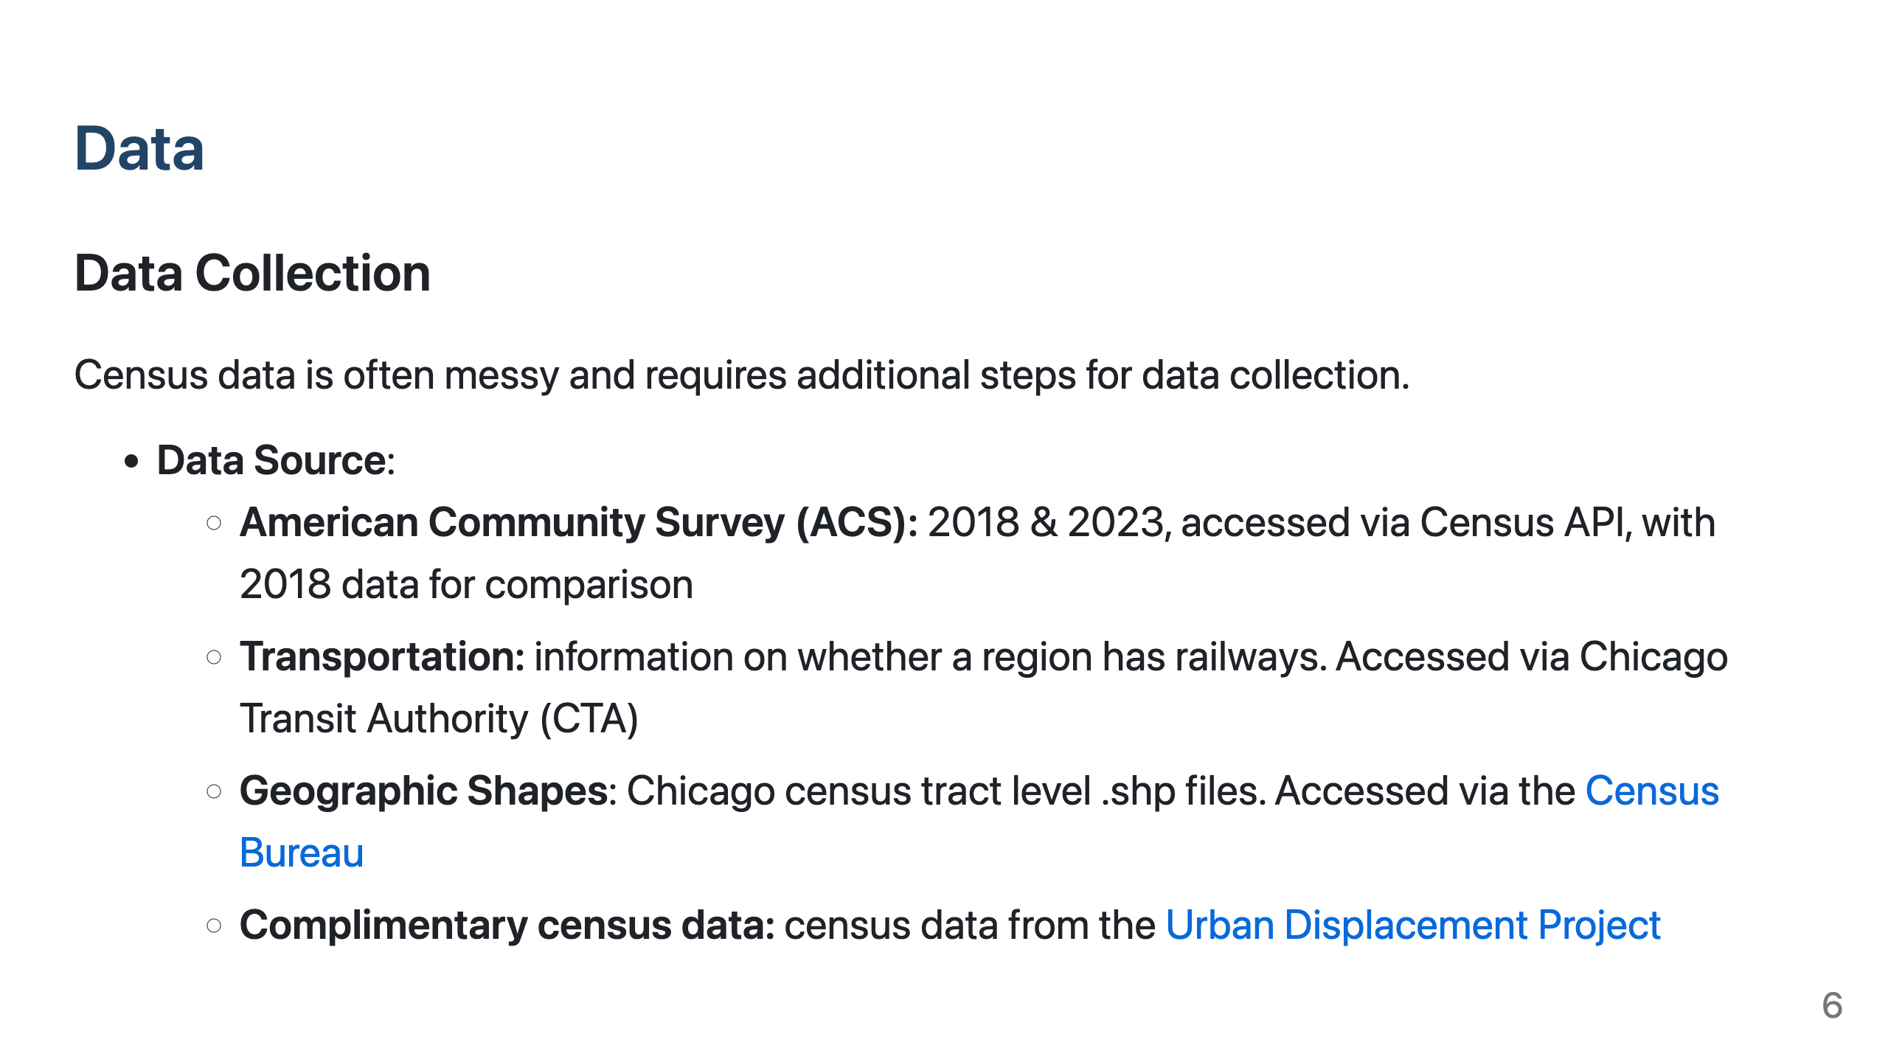
Notes:
I collected data from the following sources:
ACS
CTA
Census Bureau tract-level geographic shape files
Urban Displacement Project census data

Slide 7
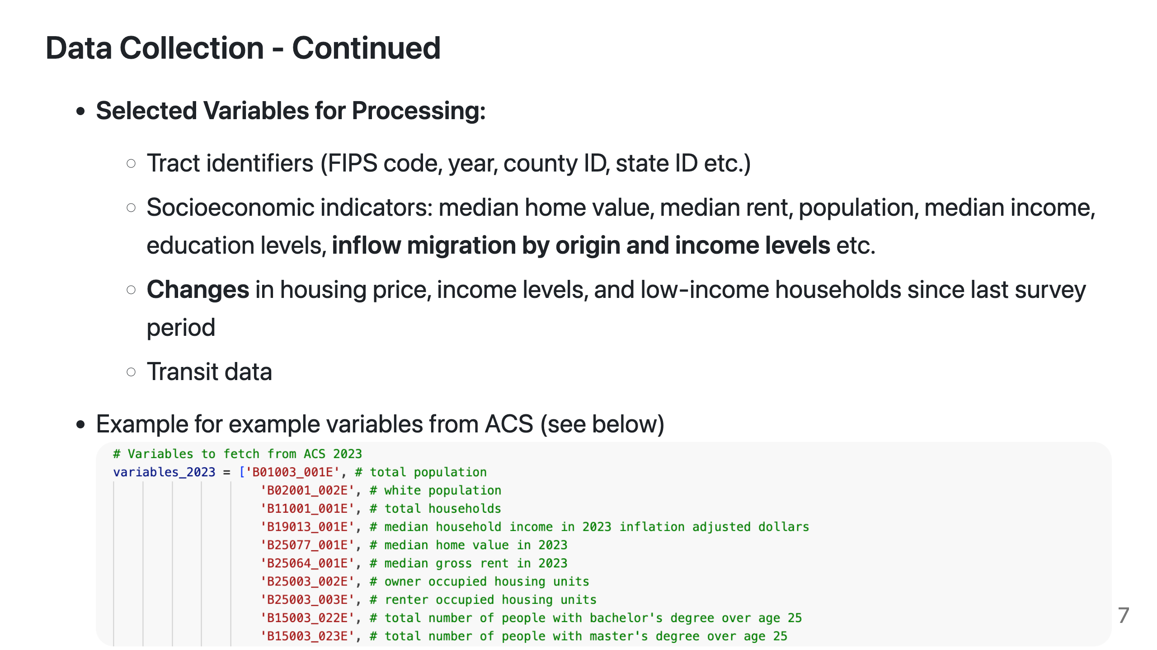
Notes:
I selected these variables based on domain knowledge.

Slide 8
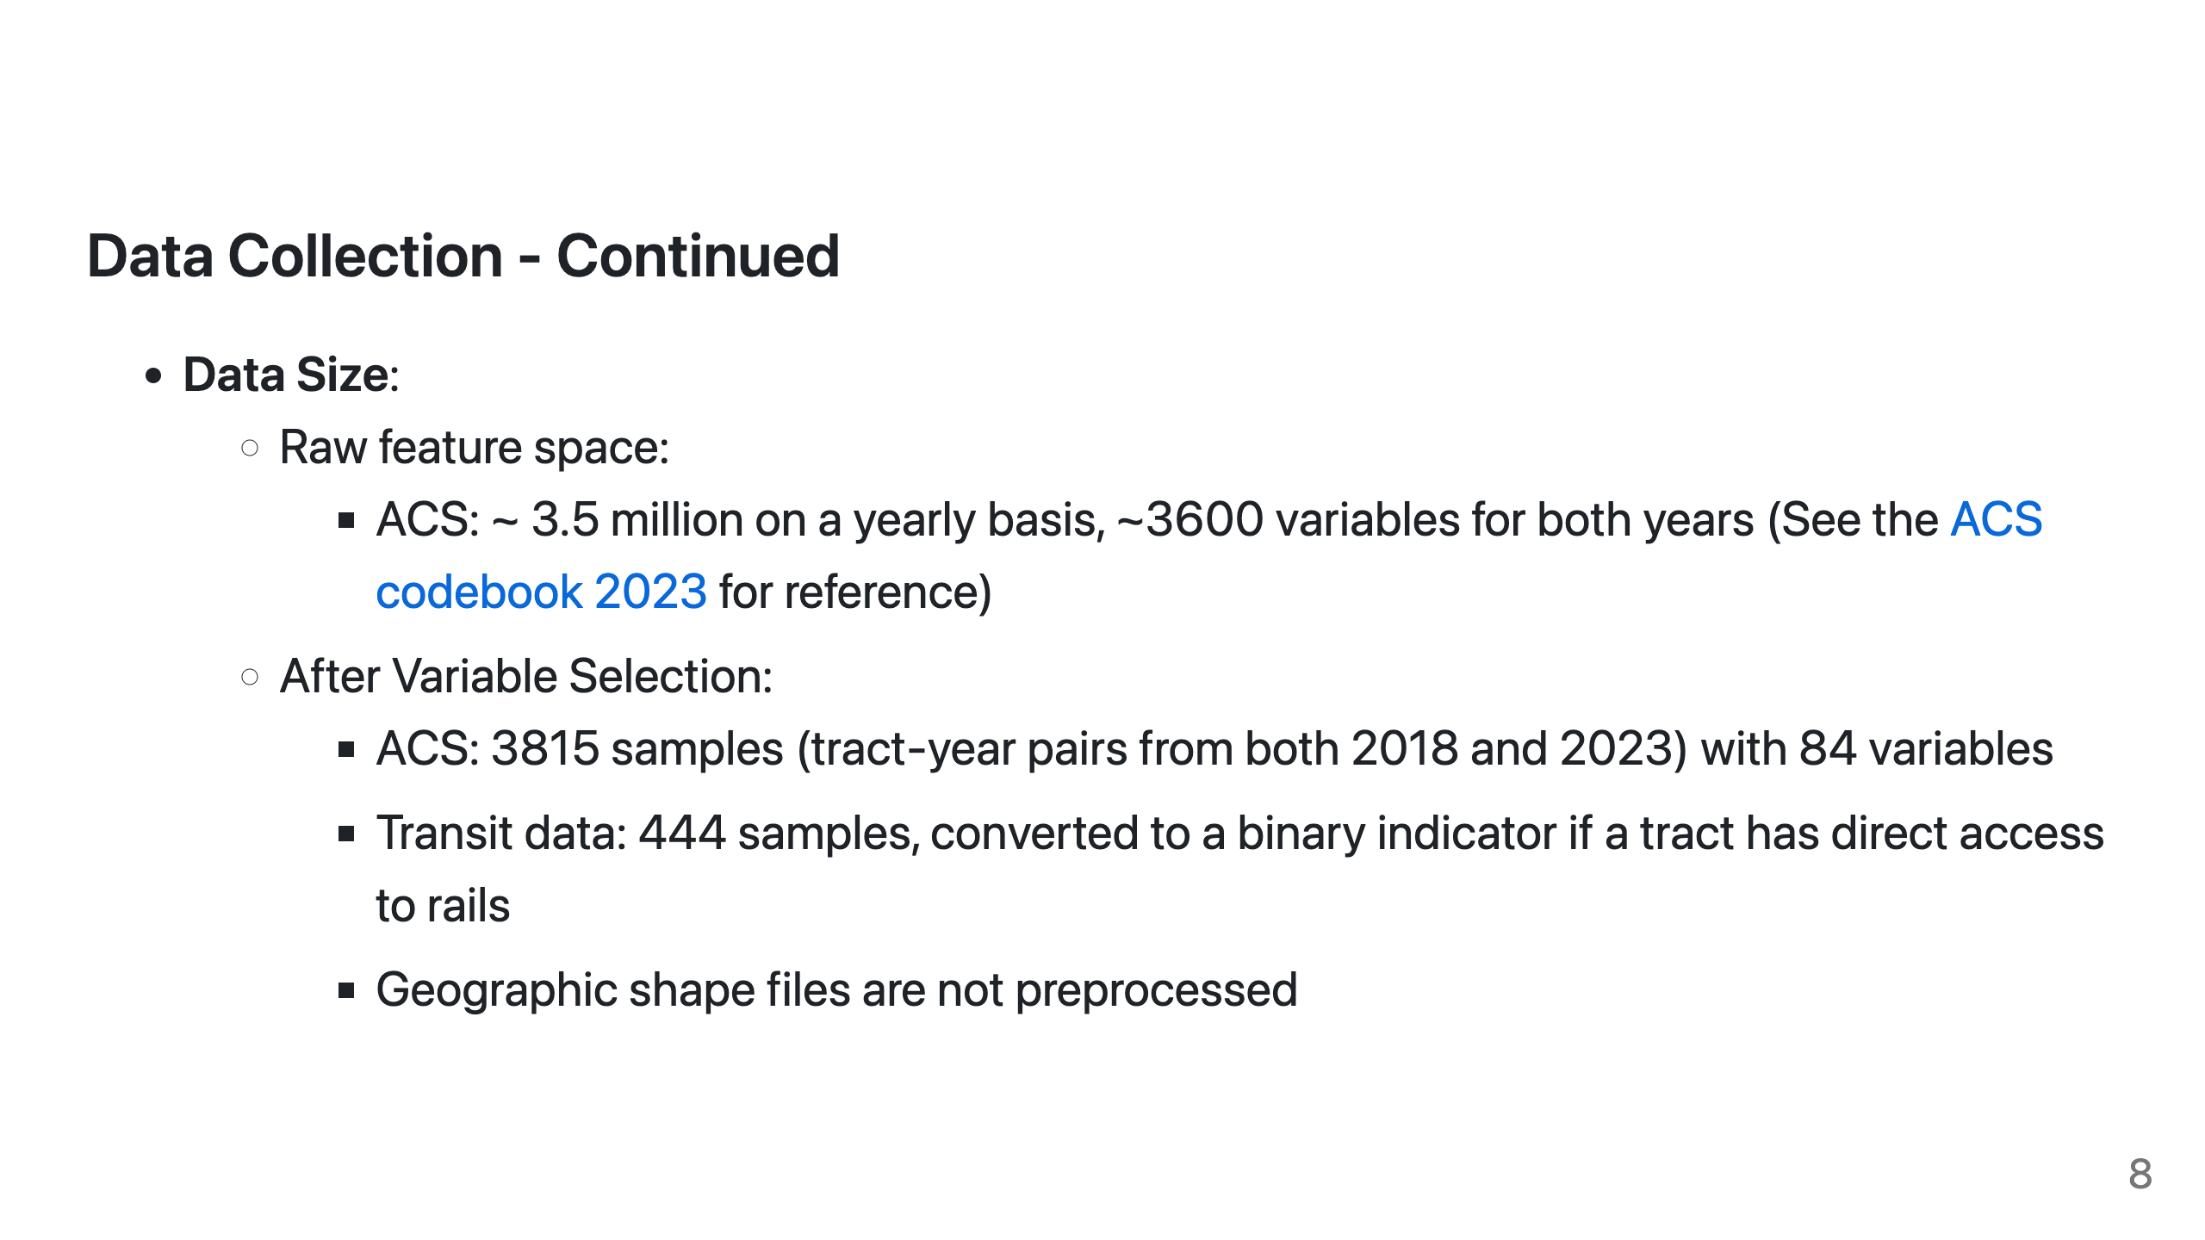
Notes:
After variable selection, I worked with 3,815 samples across 84 variables, including binary indicators for transit access.

Slide 9
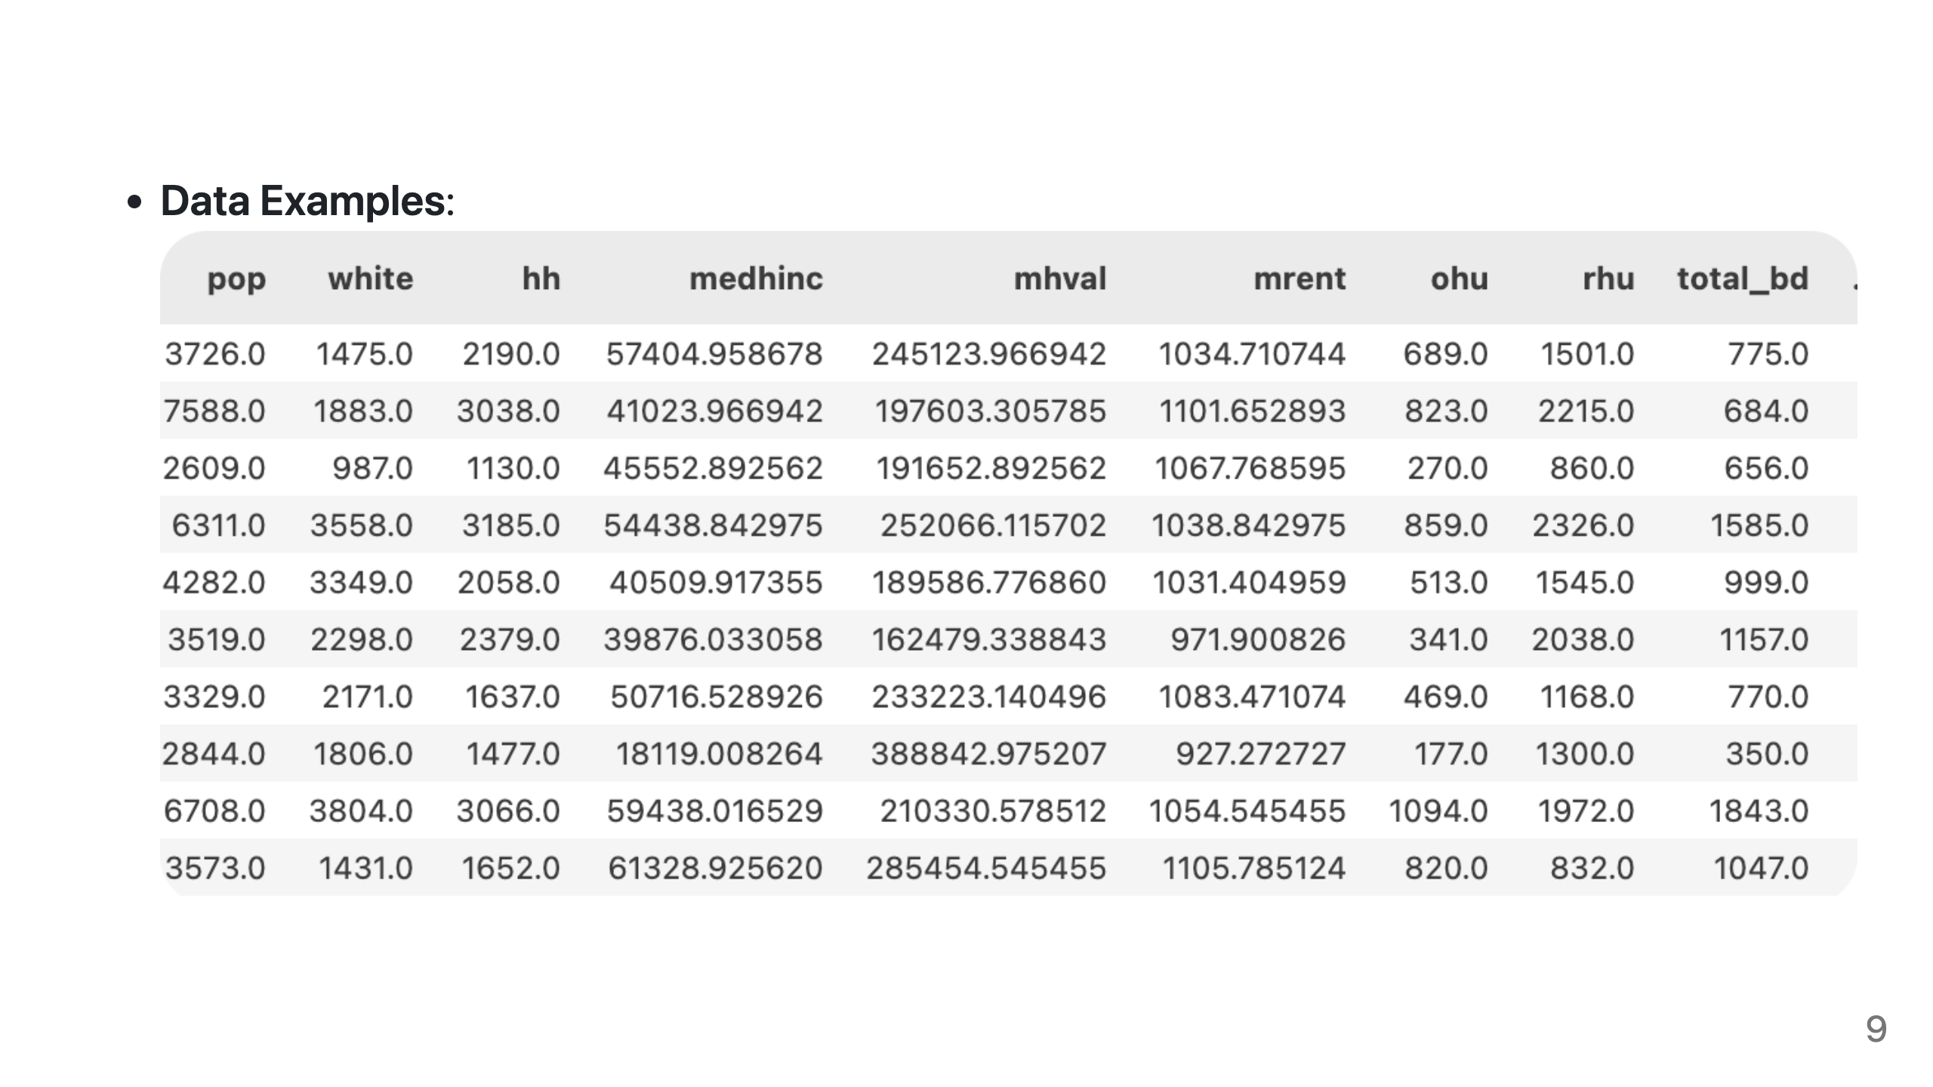
Notes:
This is an example of my data.

Slide 10
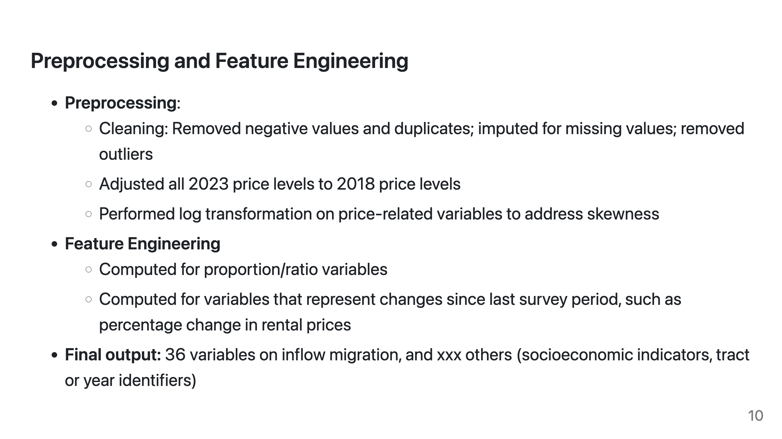
Notes:
My preprocessing steps included:
Cleaning by removing negatives, duplicates, and outliers
Adjusting 2023 prices to 2018 levels for comparison
Log-transforming price variables to address skewness
I created proportion variables and calculated changes since the previous survey period, and got 36 inflow migration-related variables.

Slide 11
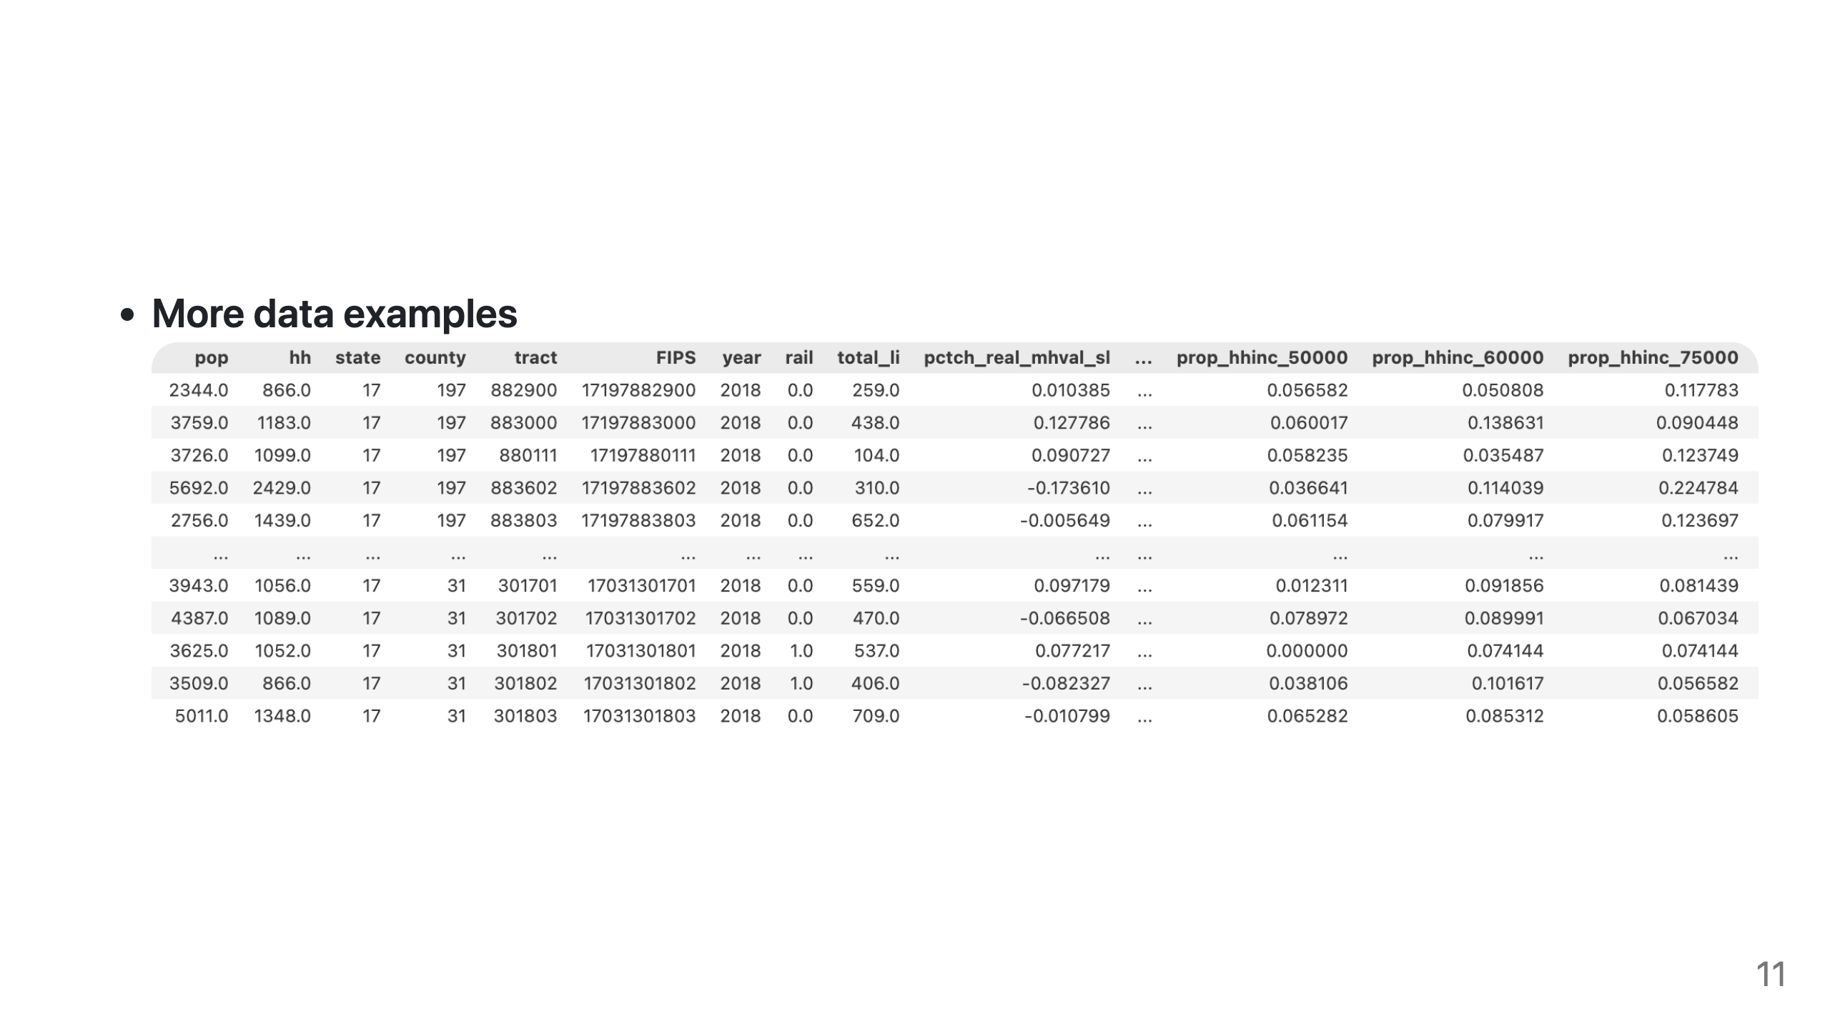

Slide 12
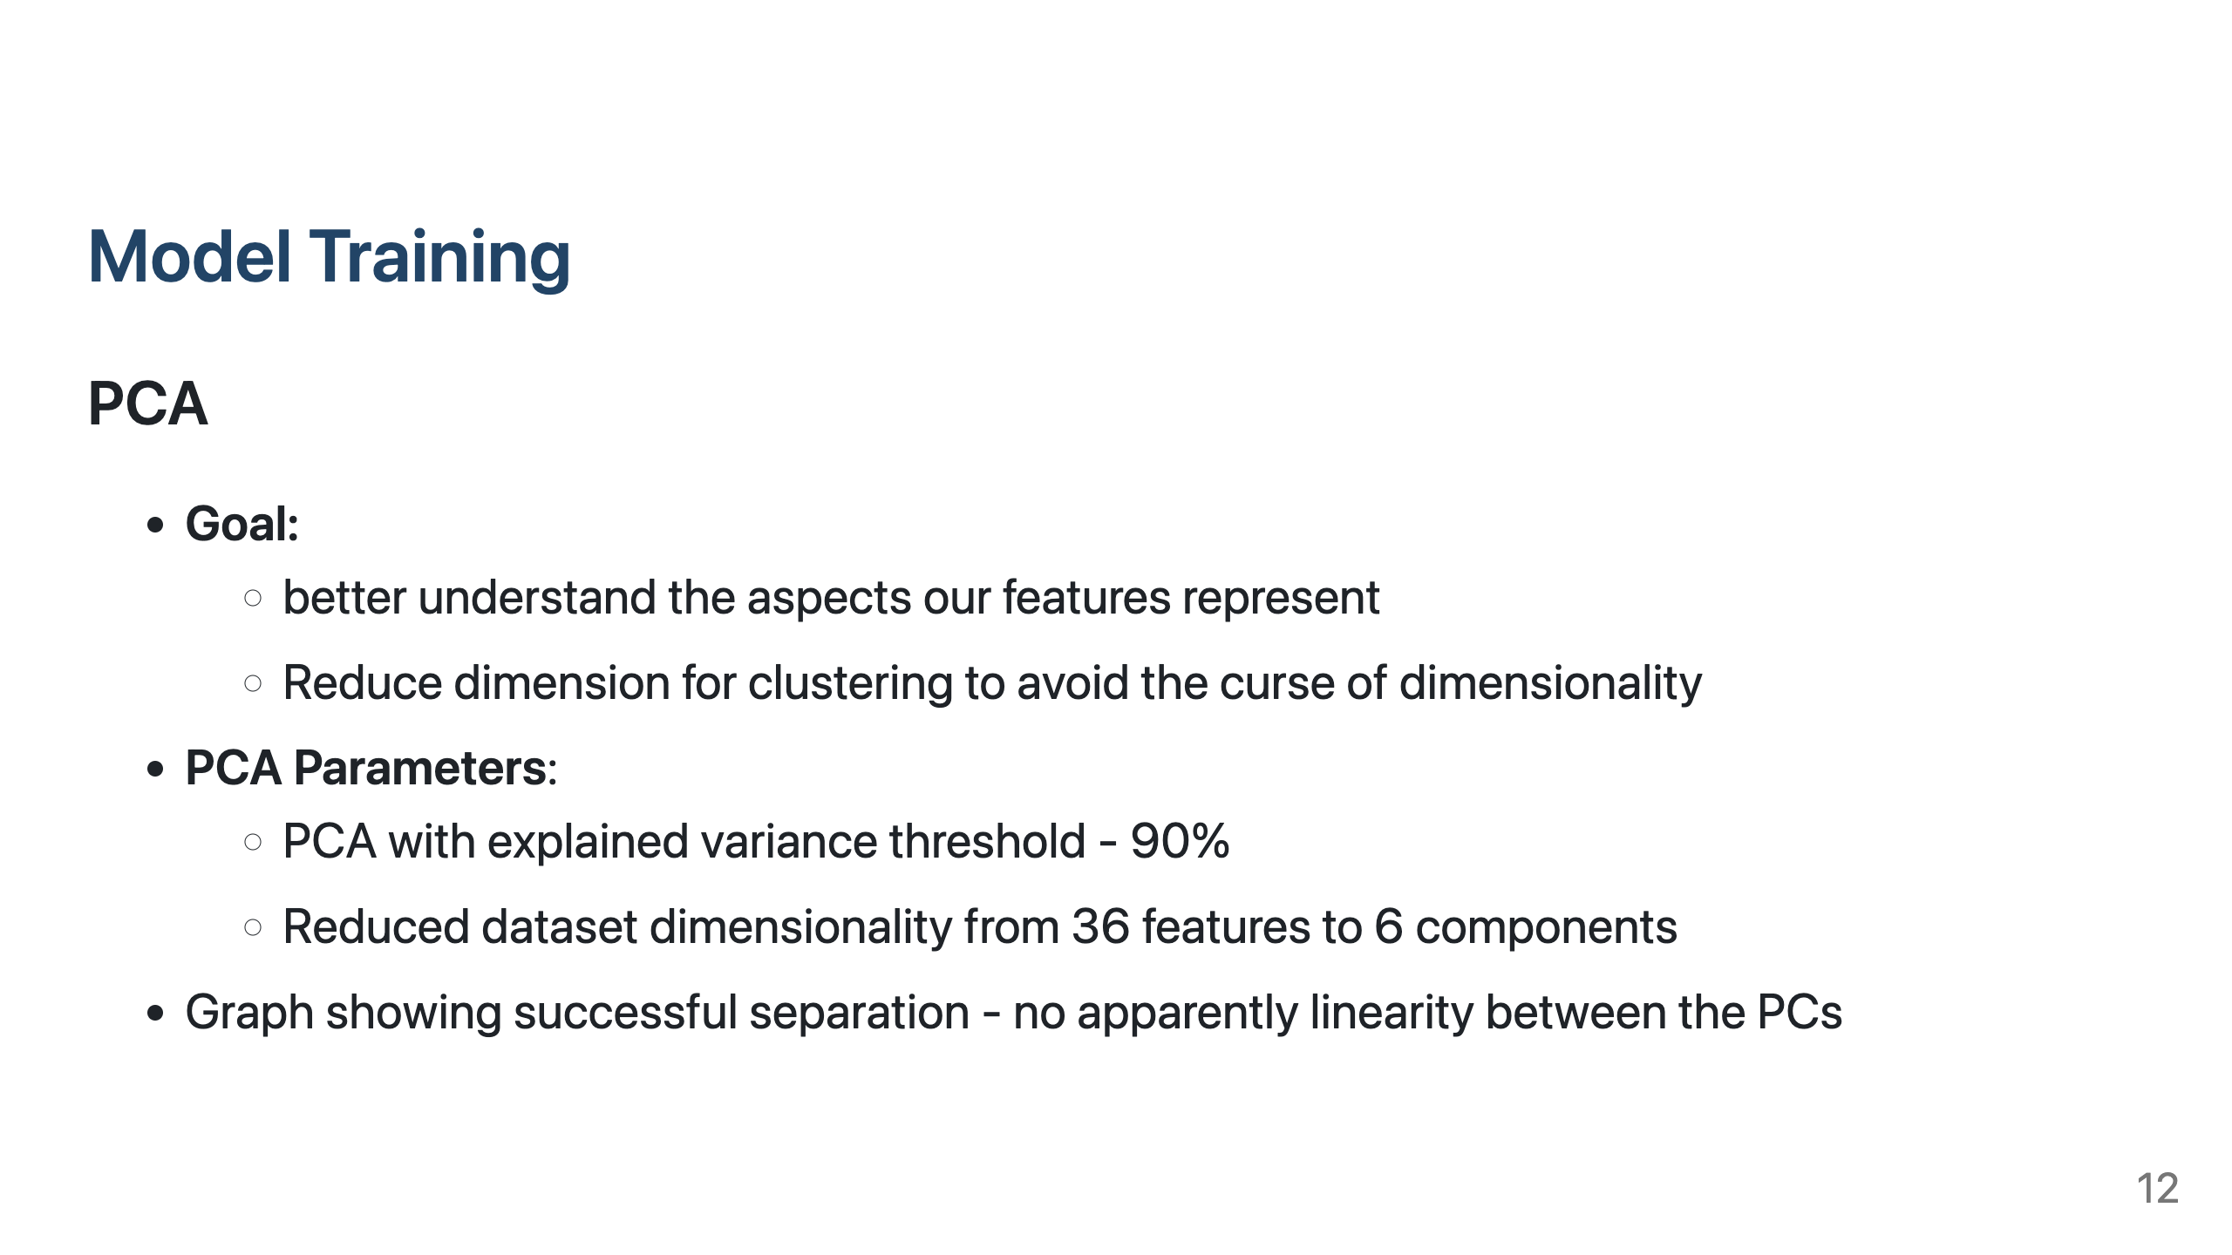
Notes:
For model training, I started by exploring my migration variables with PCA. I used PCA with a 90% explained variance threshold, which reduced our 36 features to 6 principal components.
The pairwise correlation graph shows successful separation, suggesting no apparent linearity between the PCs, which is good

Slide 13
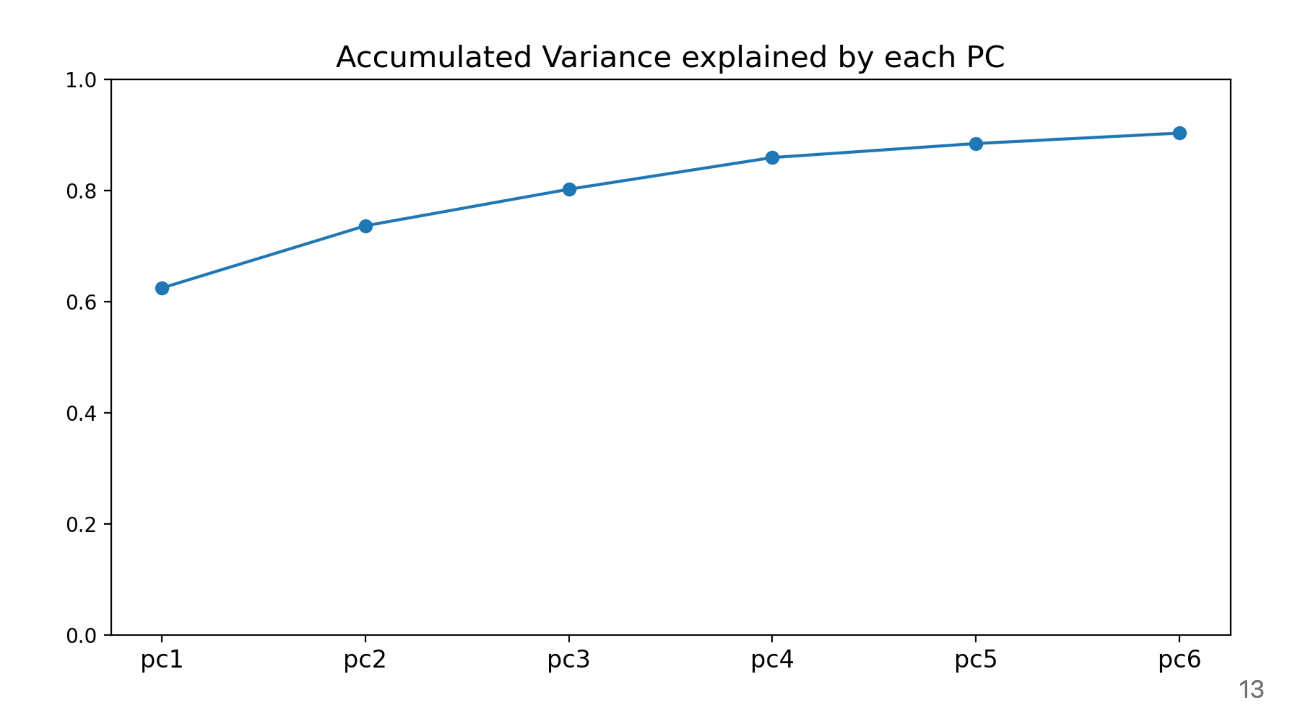

Slide 14
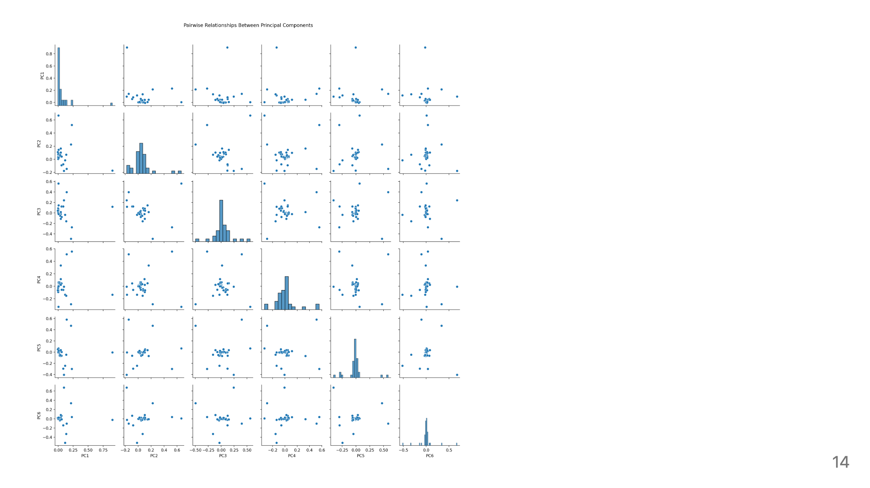
Notes:
This is our pairwise plot.

Slide 15
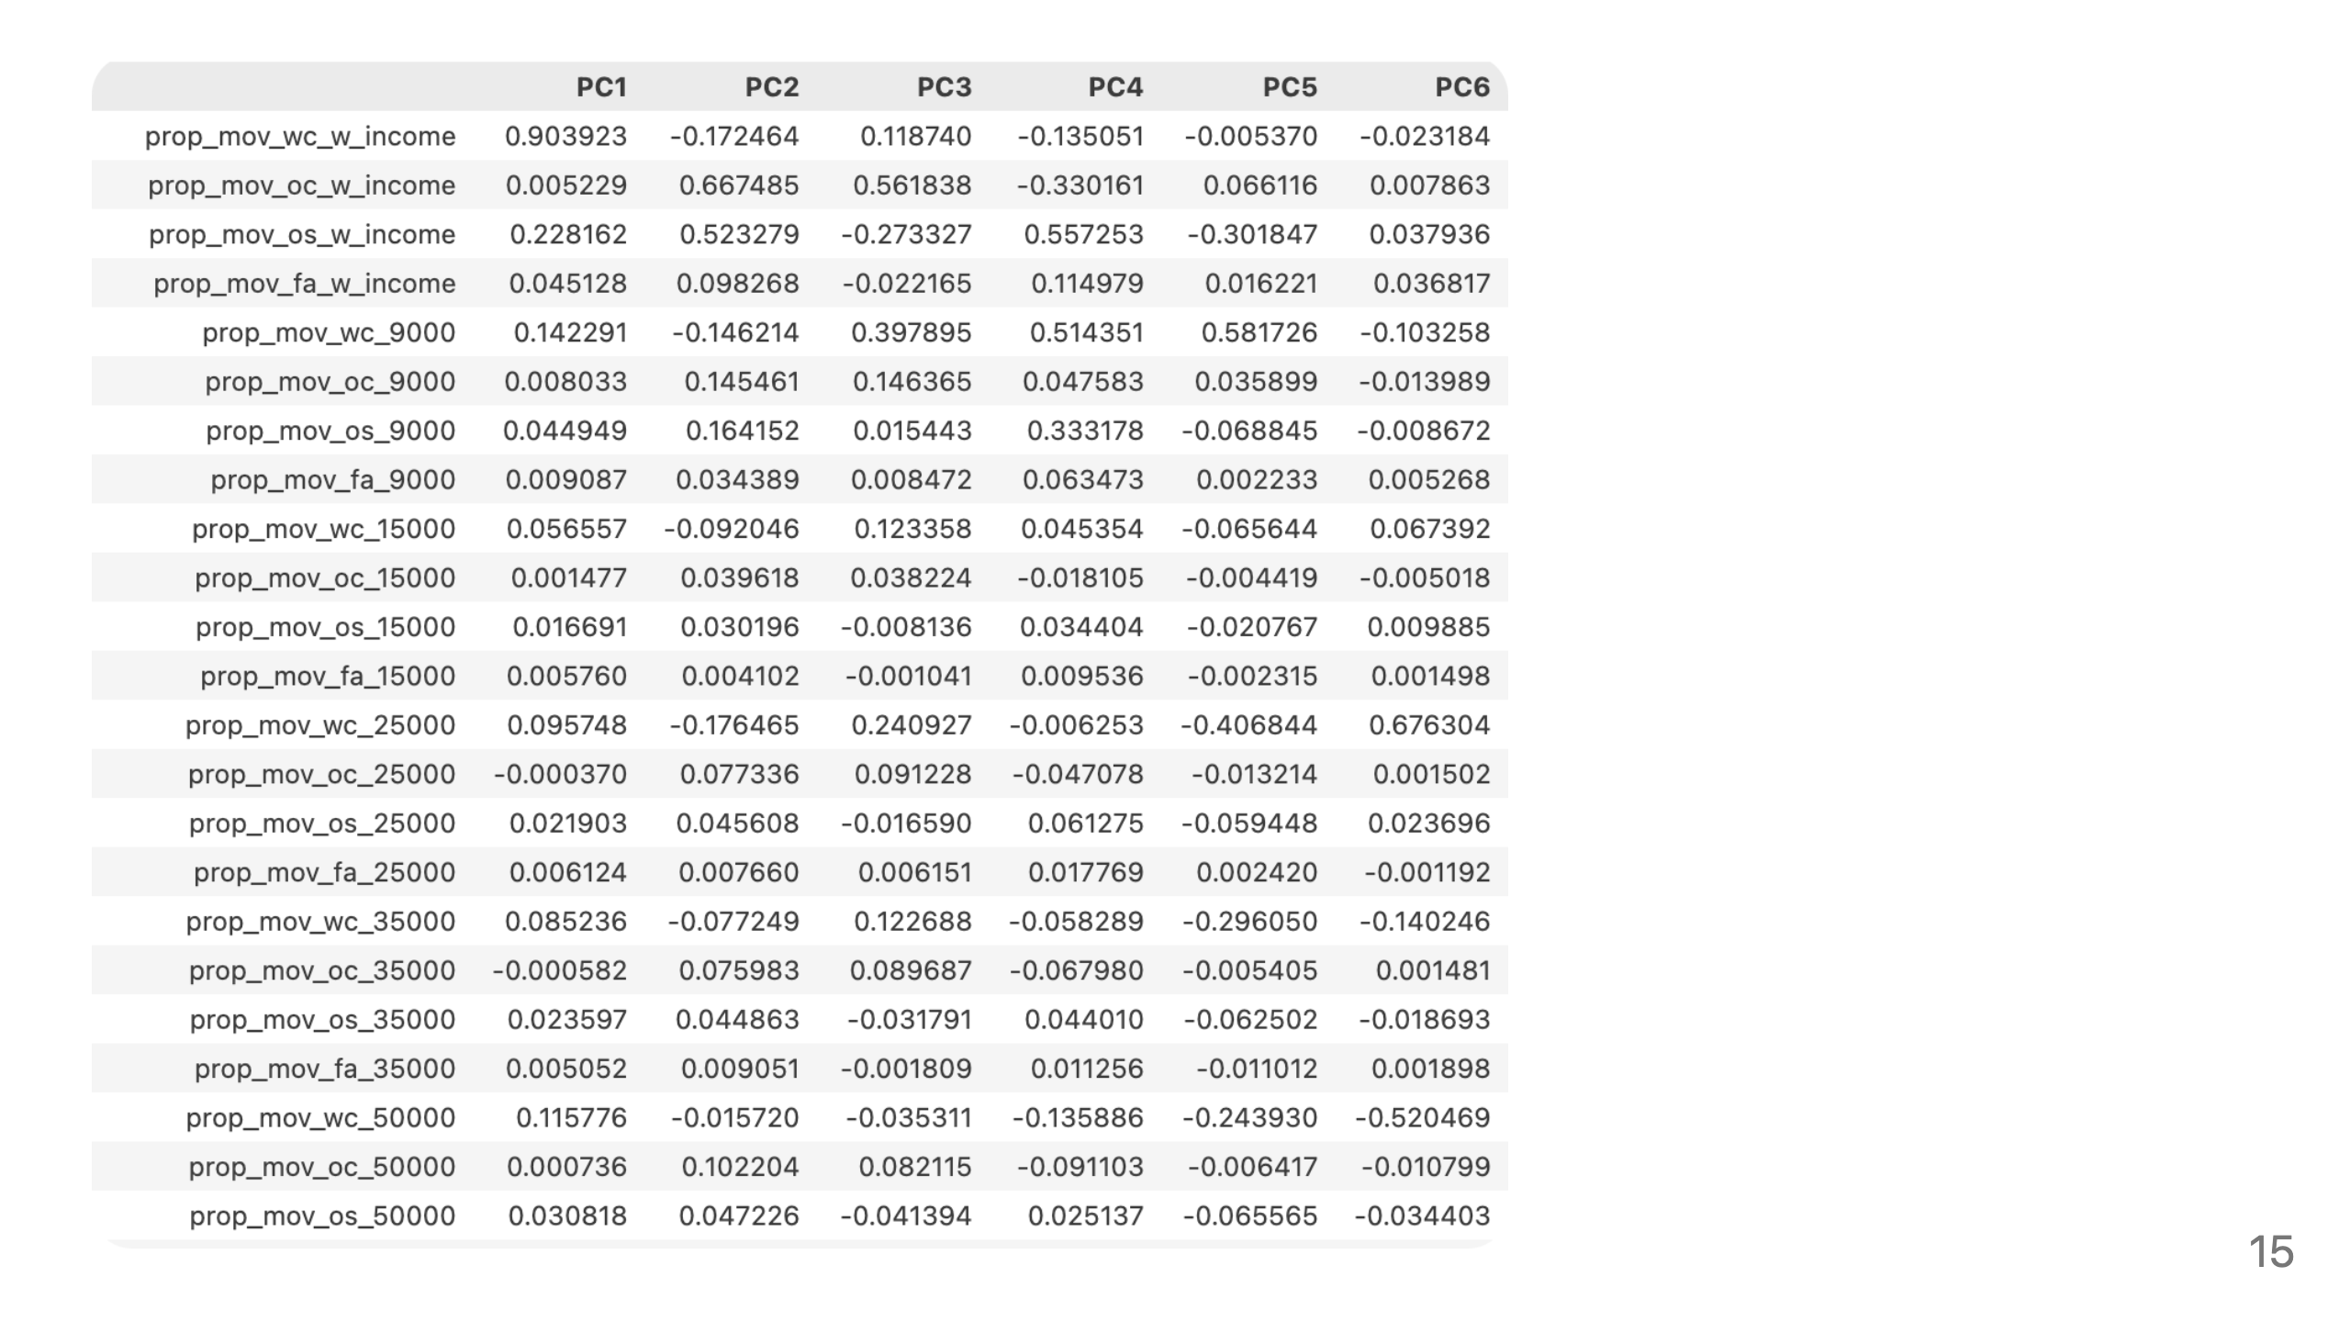
Notes:
These are the loadings for our PCs.

Slide 16
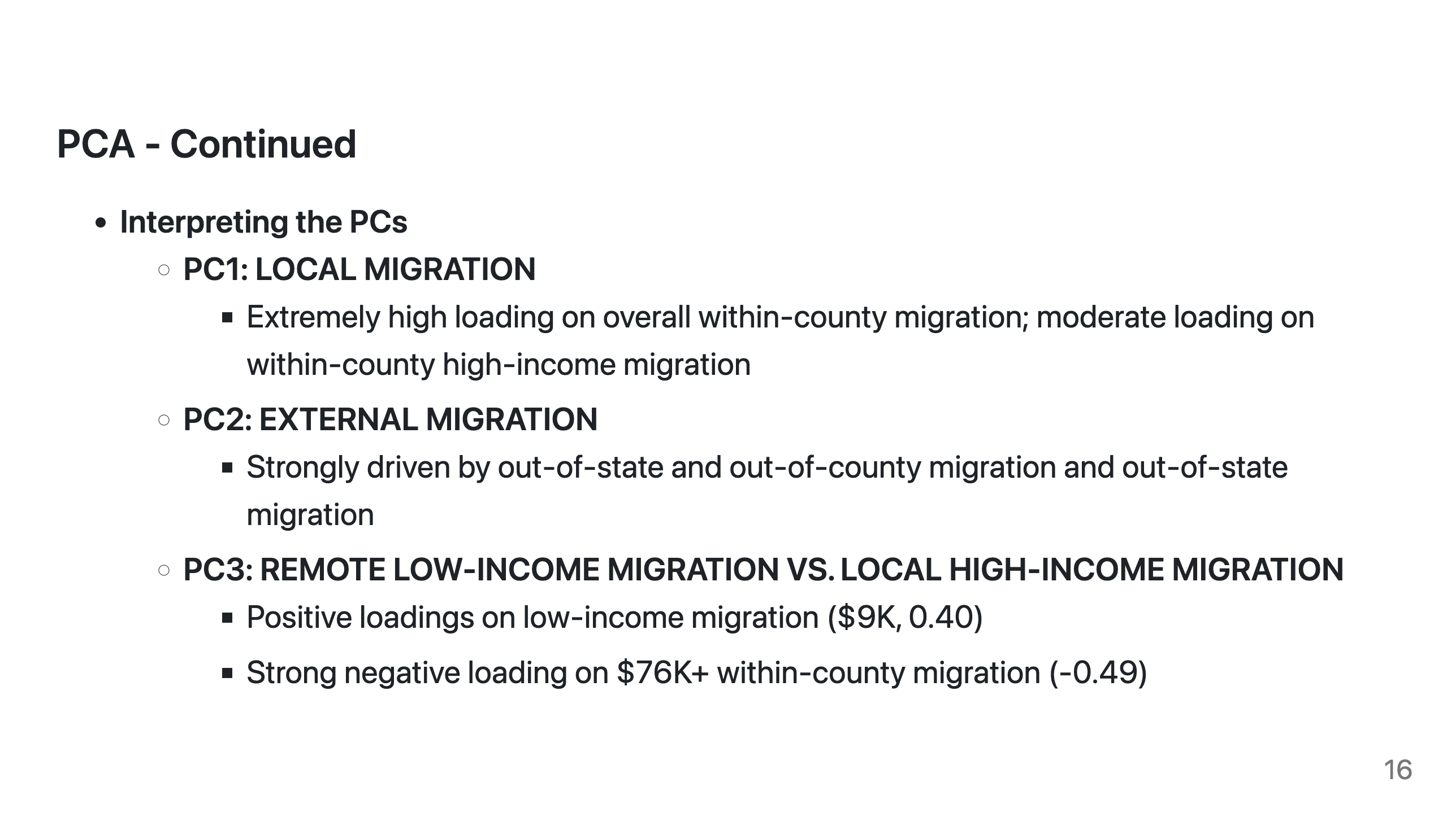
Notes:
After taking a look at the loadings, these components represent distinct aspects of migration patterns:
PC1: Local Migration
PC3: Low-income vs. High-income local migration
So on so forth.

Slide 17
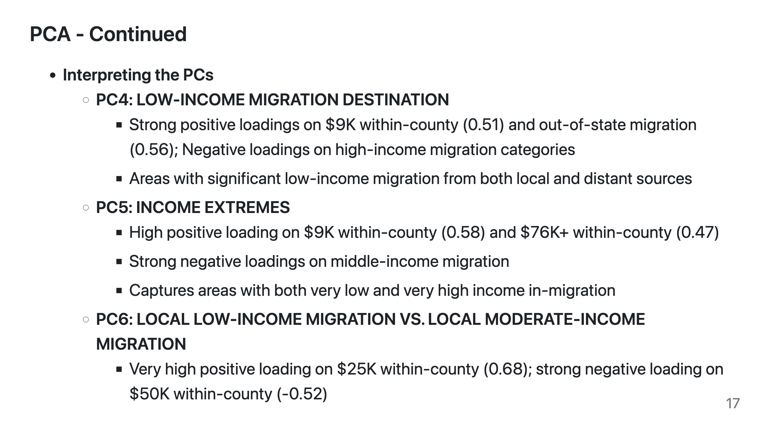

Slide 18
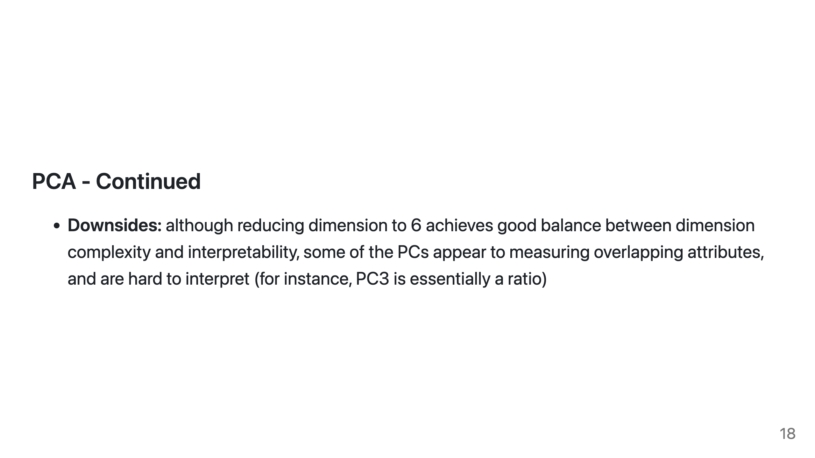
Notes:
One downside to consider is that some of the PCs appear to be measuring overlapping attributes.

Slide 19
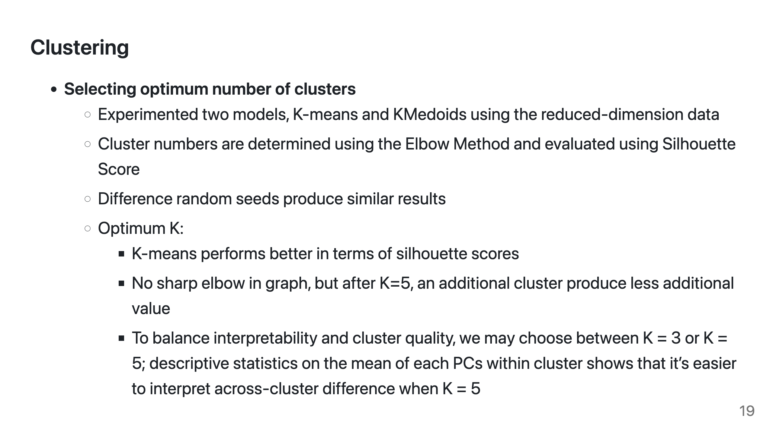
Notes:
I use the PCA transformed data for clustering. I eventually settled on 5 clusters based on silhouette scores, the elbow method, and interpretability.

Slide 20
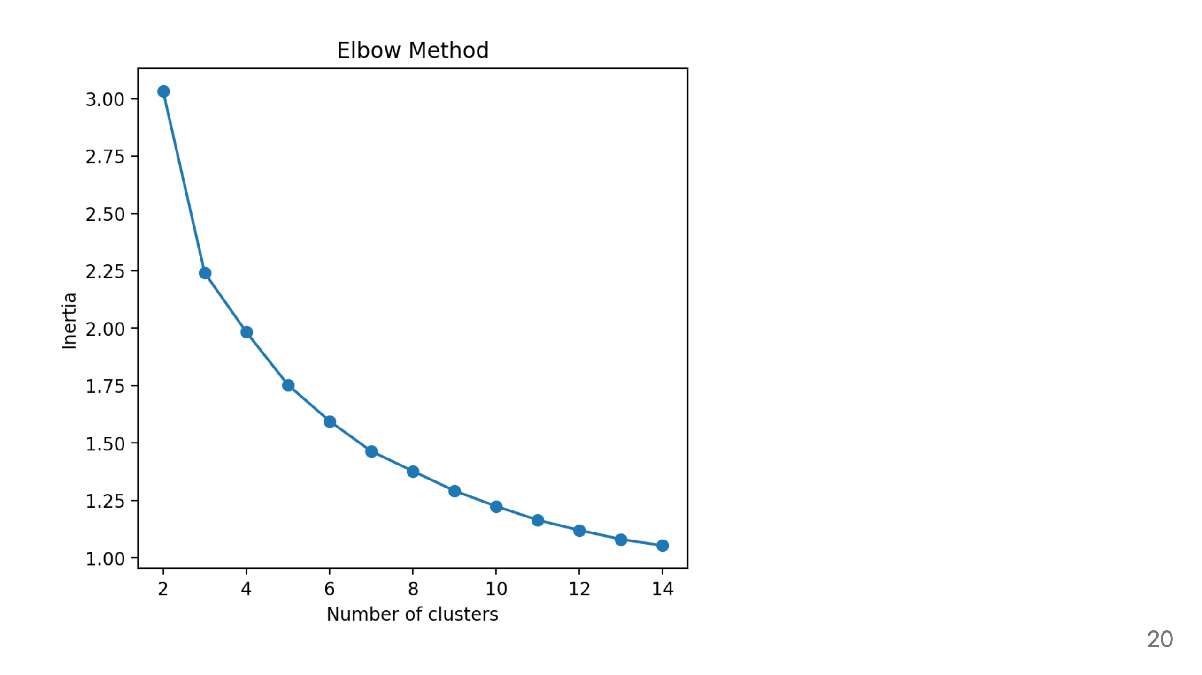
Notes:
Graph showing elbow method

Slide 21
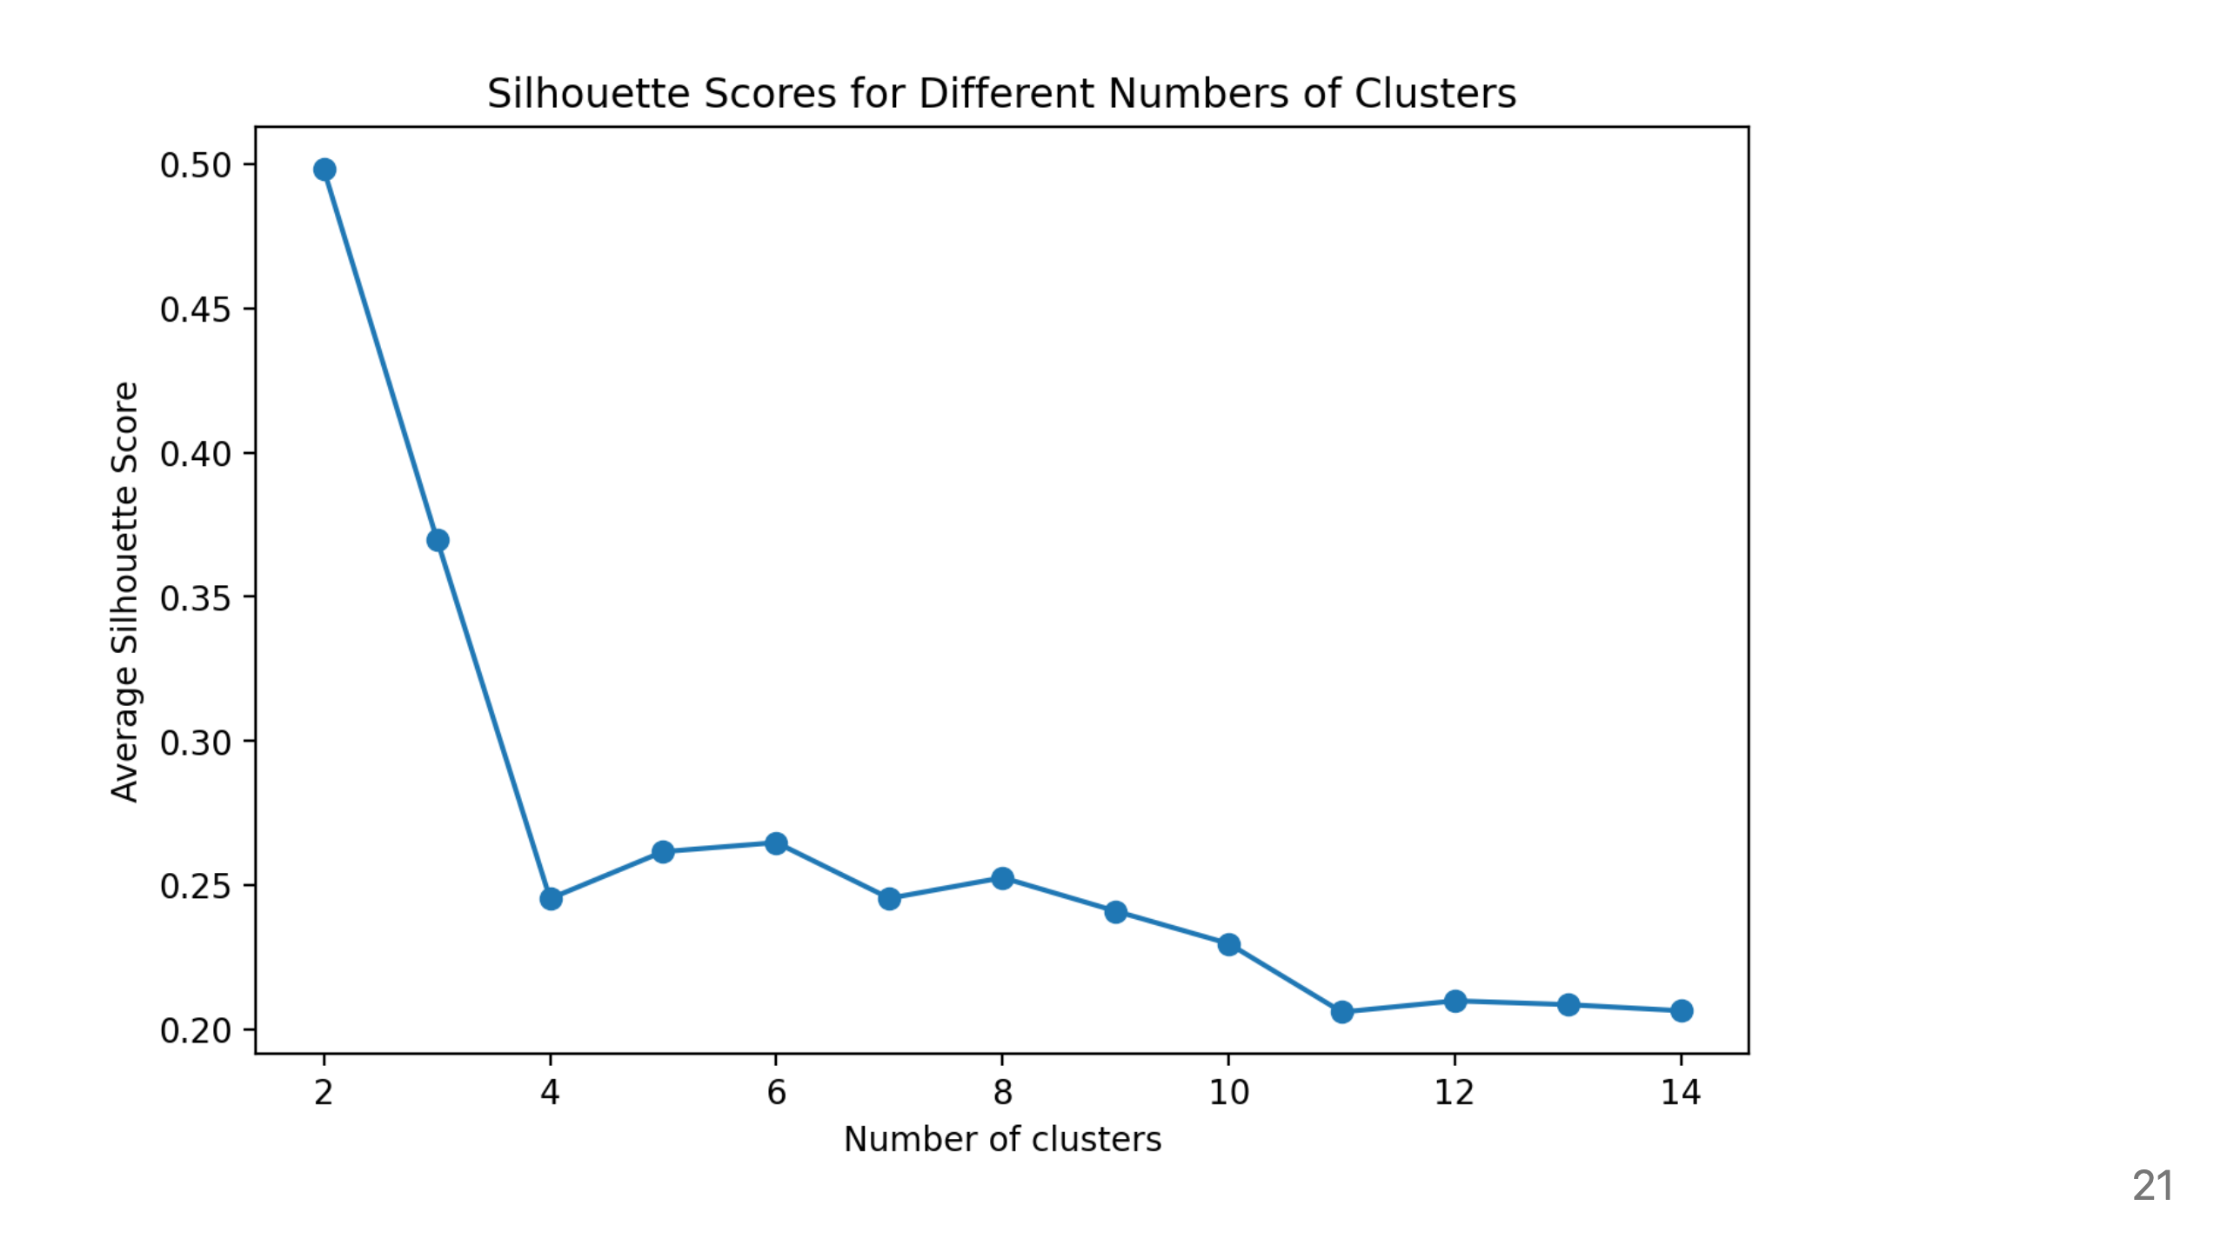

Slide 22
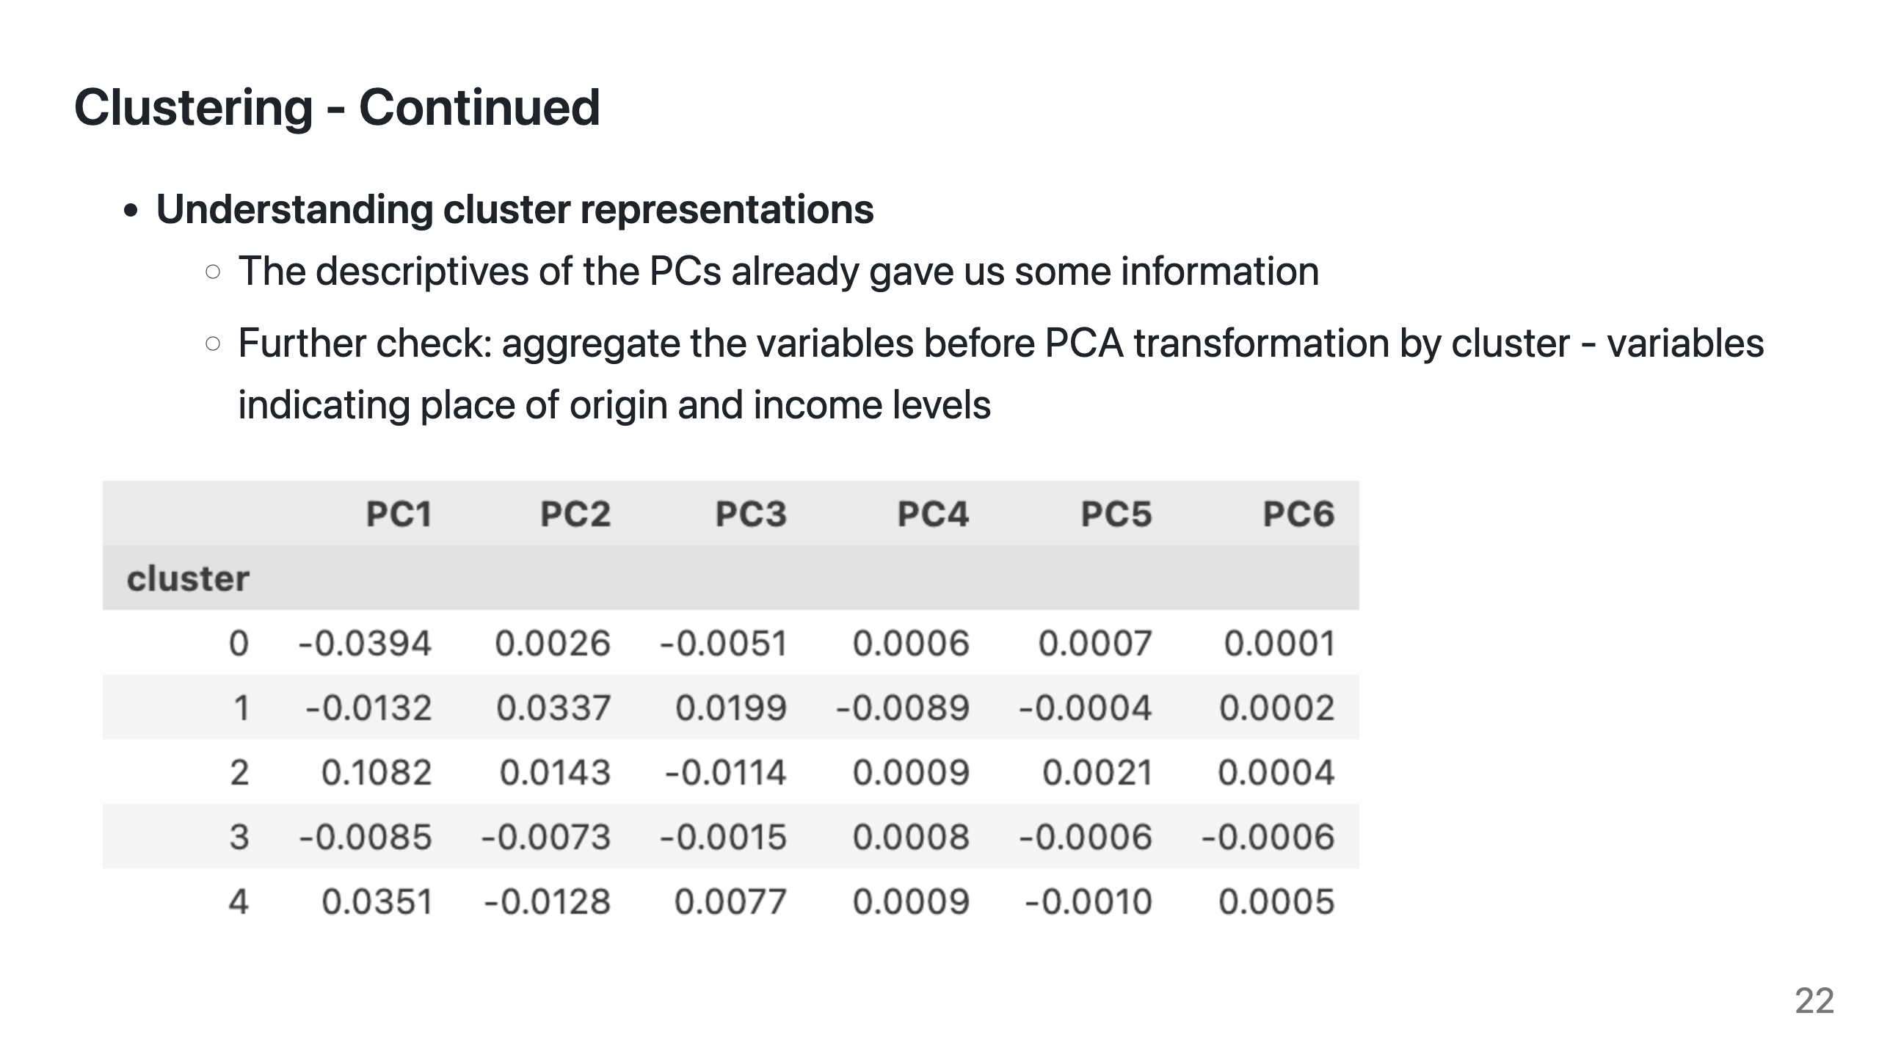
Notes:
From here on, I ran some descriptive analysis to better understand what each cluster represent.

Slide 23
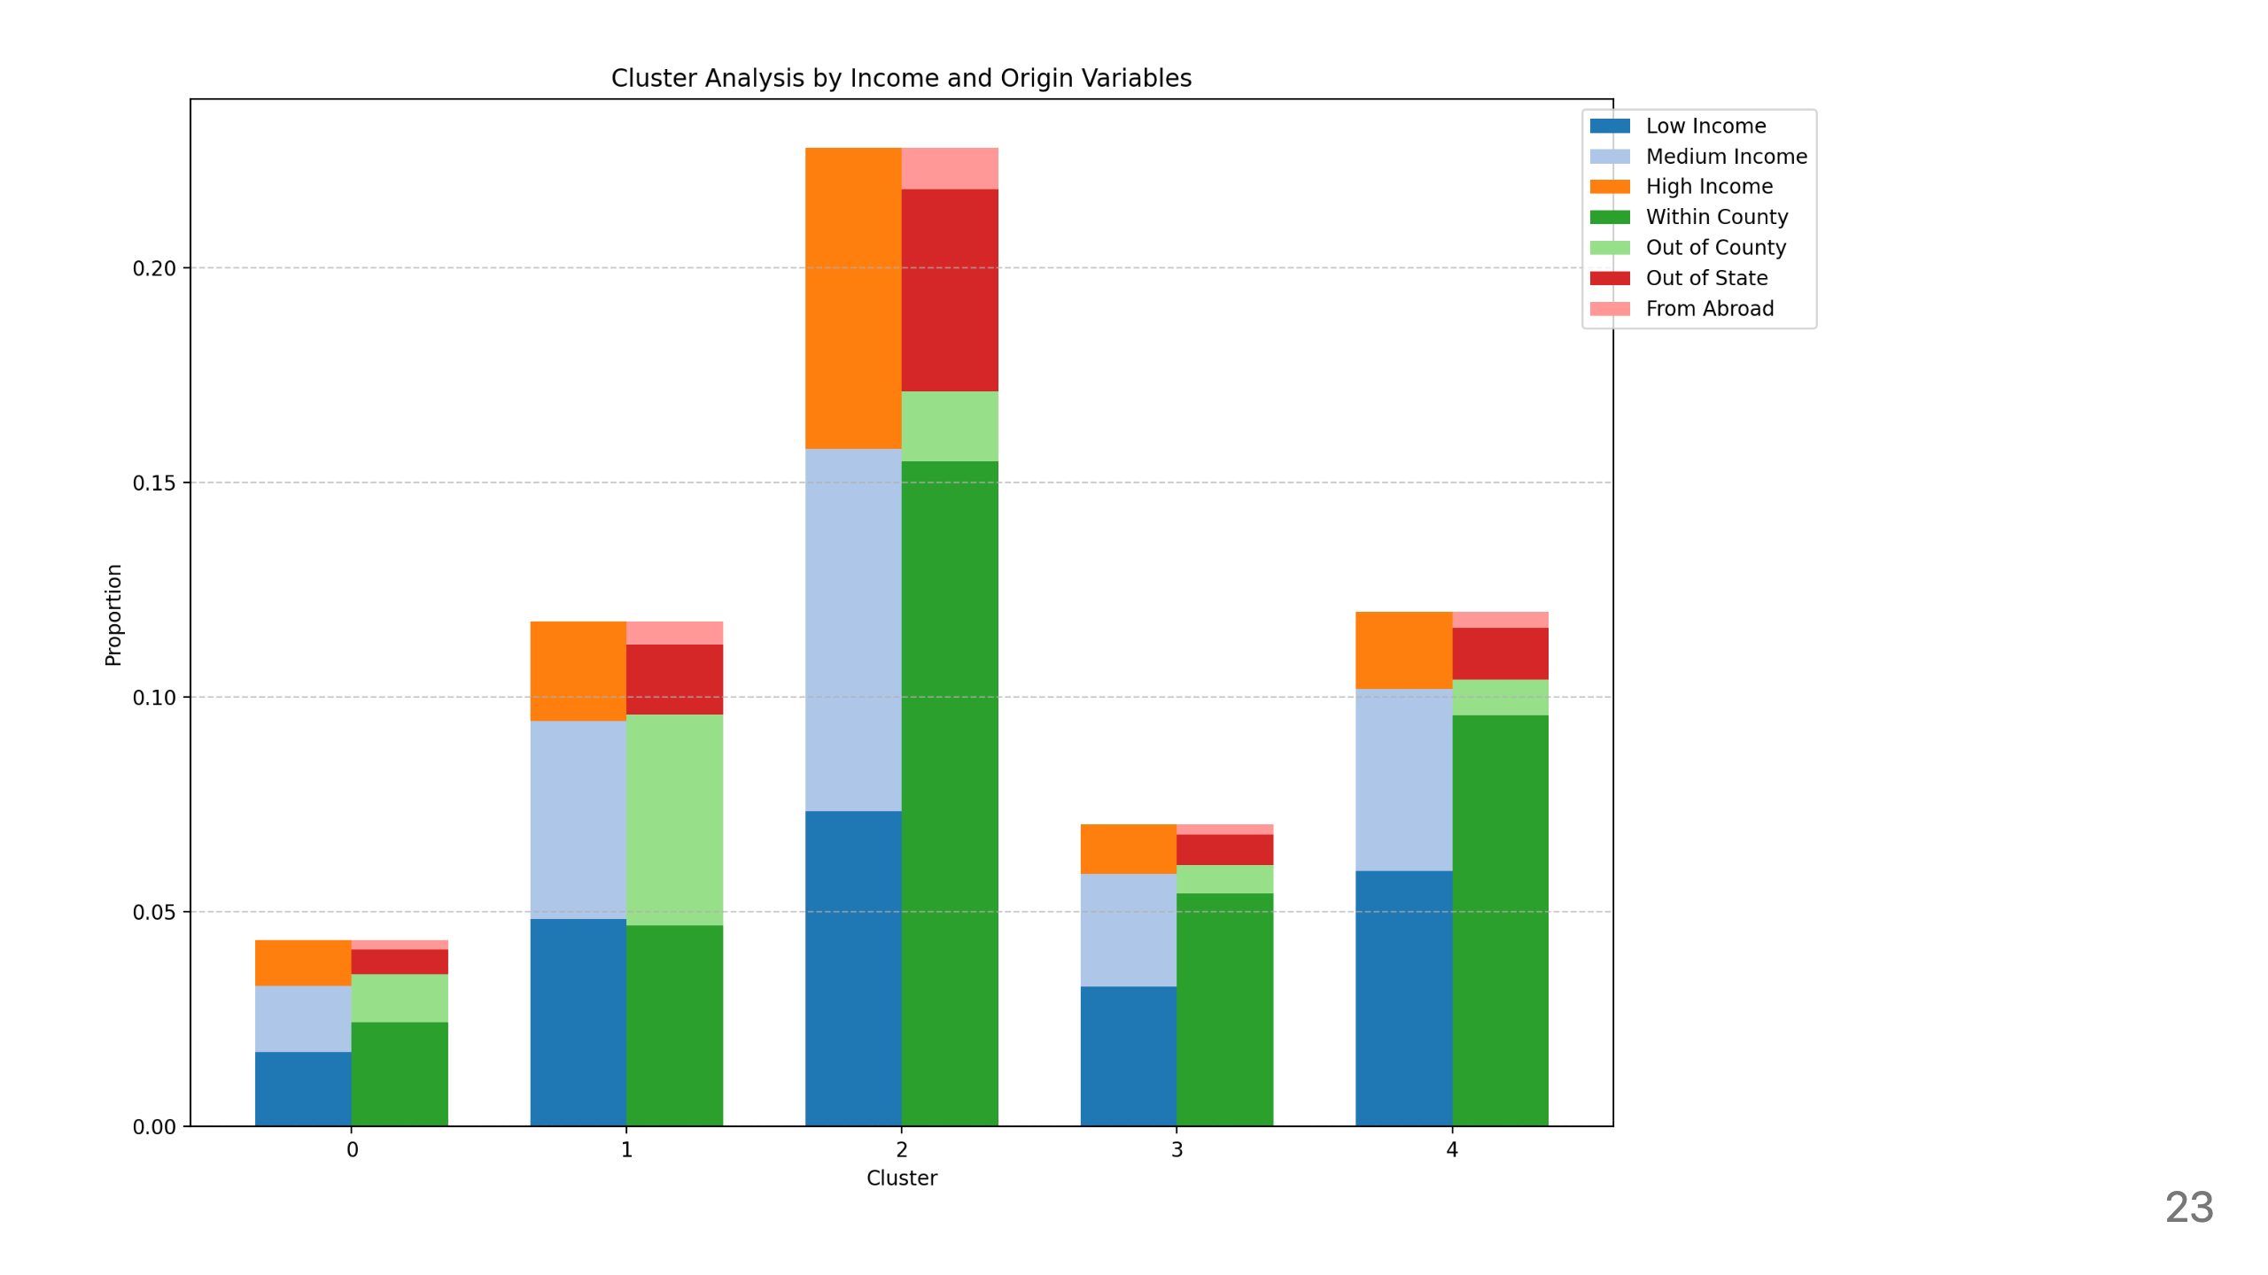
Notes:
This graph shows the absolute proportions of different types of inflow migration population.
- Cluster 2 shows the highest overall migration activity, with strong representation from both high-income migrants and out-of-state migrants
Cluster 0 has minimal inflow across all categories
Clusters 1 and 4 show moderate inflow with different patterns - cluster 1 drawing more from outside the county while cluster 4 has more within-county migration
Cluster 3 shows low overall inflow but maintains some movement

Slide 24
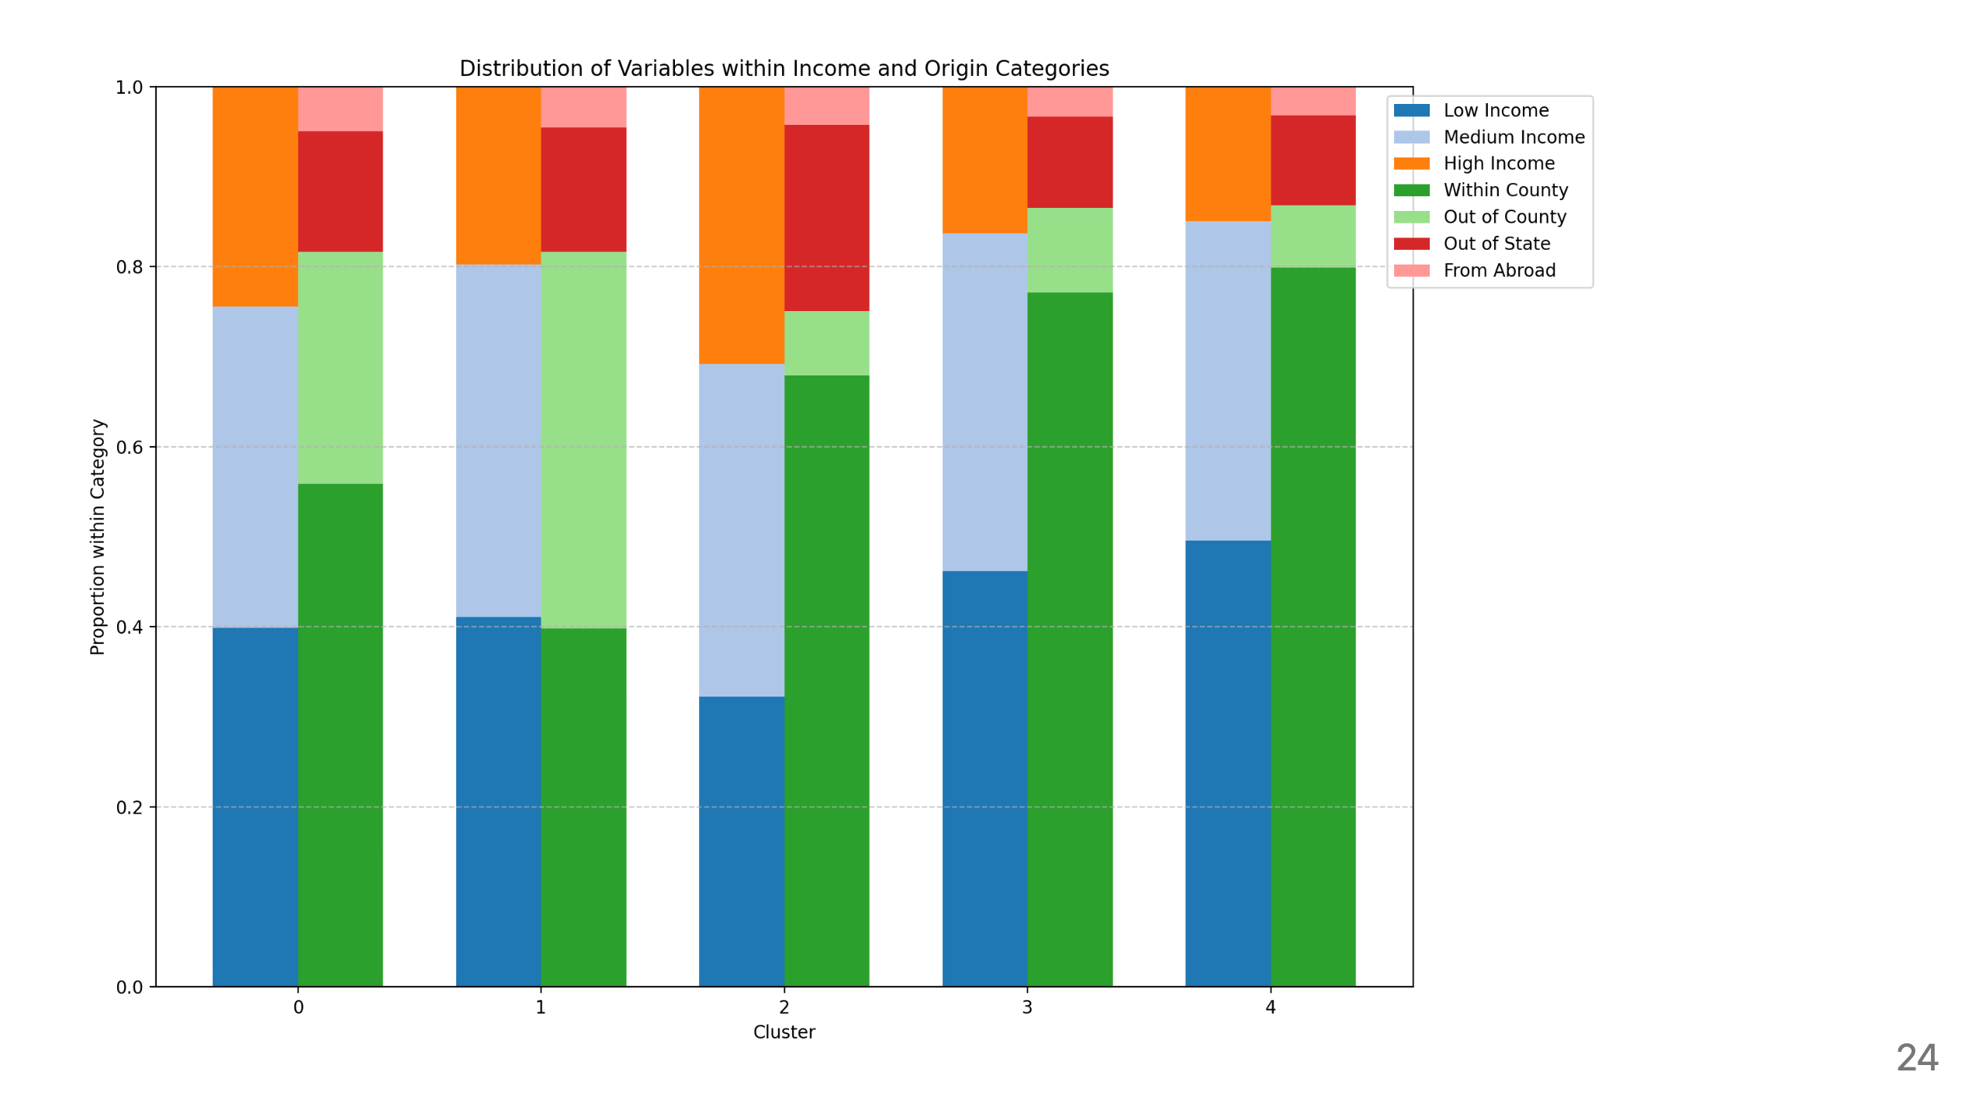
Notes:
For this graph that shows relative distributions, it’s clearer to see that cluster 2 has the lowest proportion of low-income migrants (32%) but highest proportion of high-income migrants.
Cluster 4 shows the highest proportion of low-income migrants (50%) within its income distribution

Slide 25
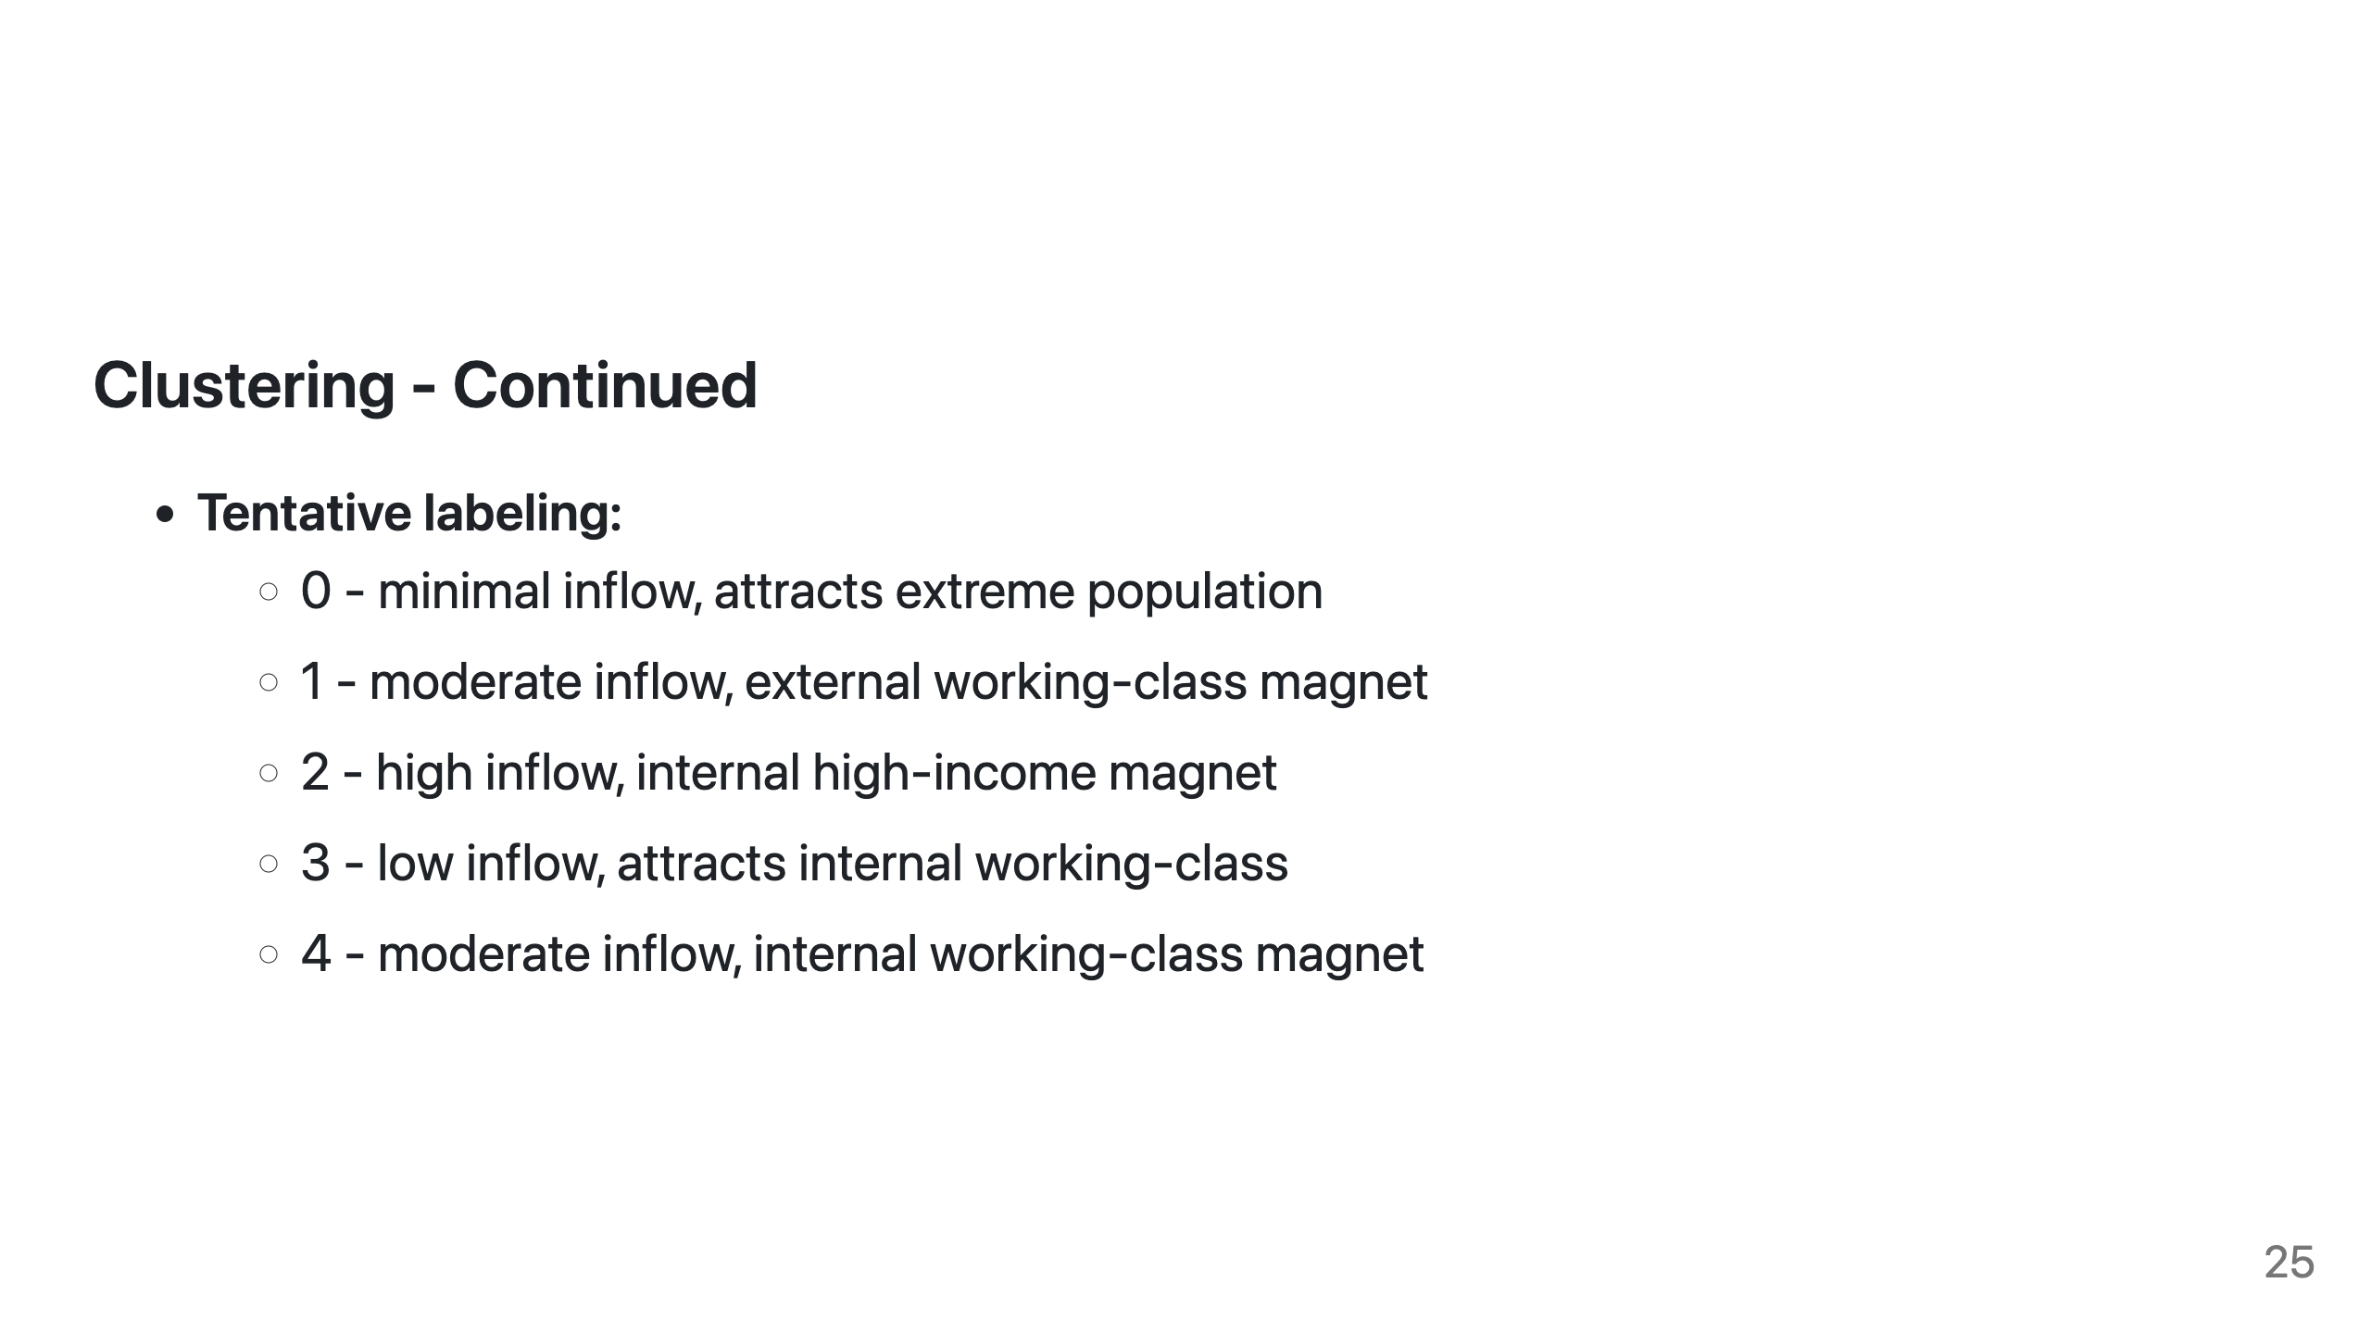
Notes:
Looking at the visualization of these clusters, we can identify five distinct migration patterns:
0. Minimal inflow areas that attract population from income extremes
1. Moderate inflow areas serving as external working-class magnet (skip the rest if no time)
2. High inflow areas that are internal high-income magnet
3. Low inflow areas attracting internal working-class residents
4. Moderate inflow areas functioning as internal working-class magnets

Slide 26
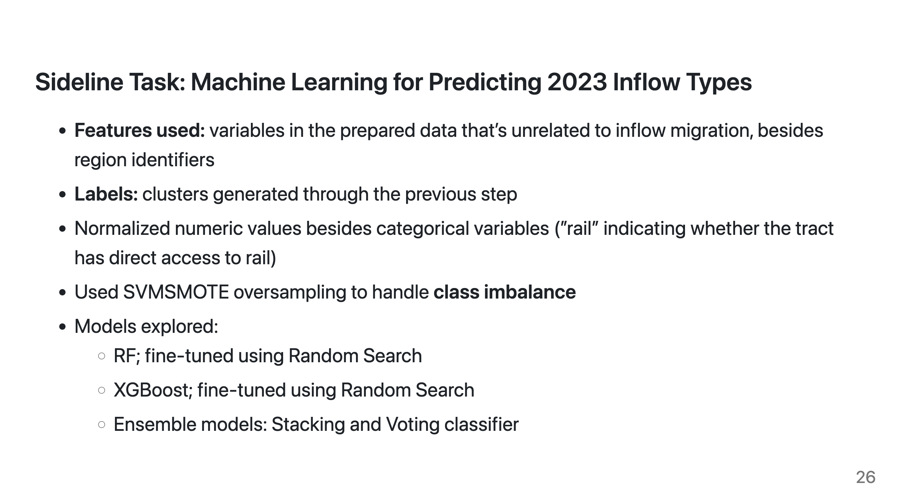
Notes:
To predict these clusters using other neighborhood features, and to generate labels for 2023, I tried several machine learning models including RF, XGBoost, and ensemble methods.

Slide 27
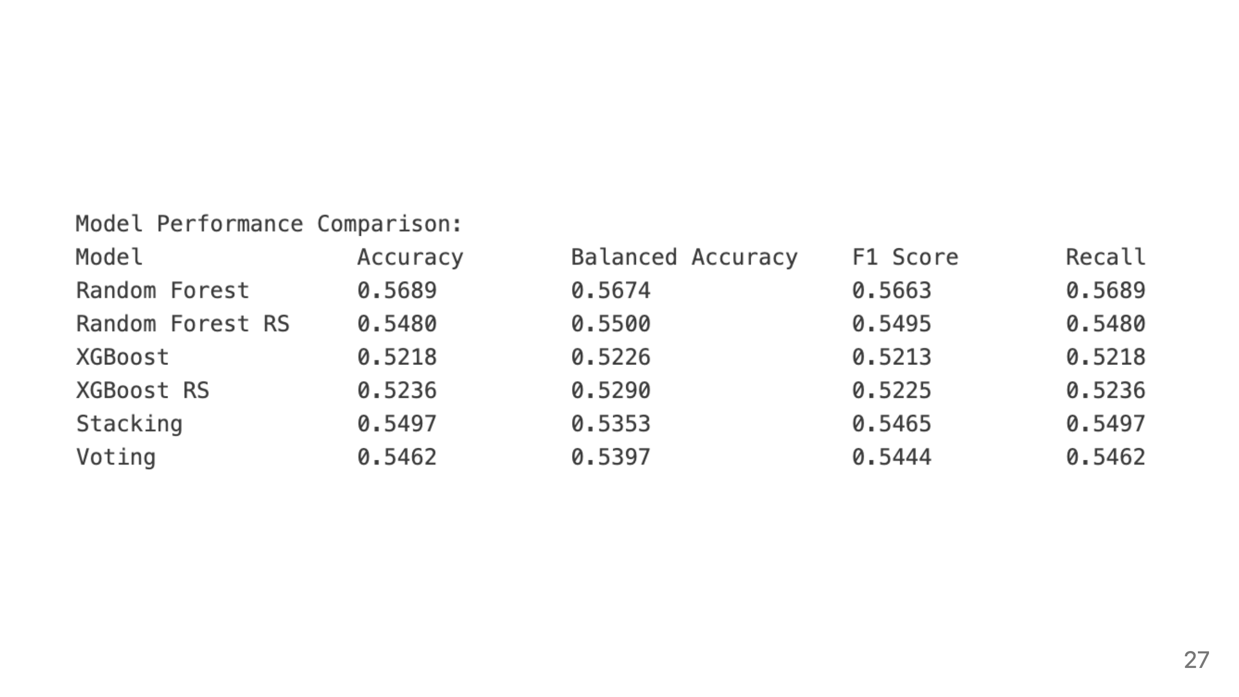
Notes:
This table shows that RF has the best performance. We use it for prediction.

Slide 28
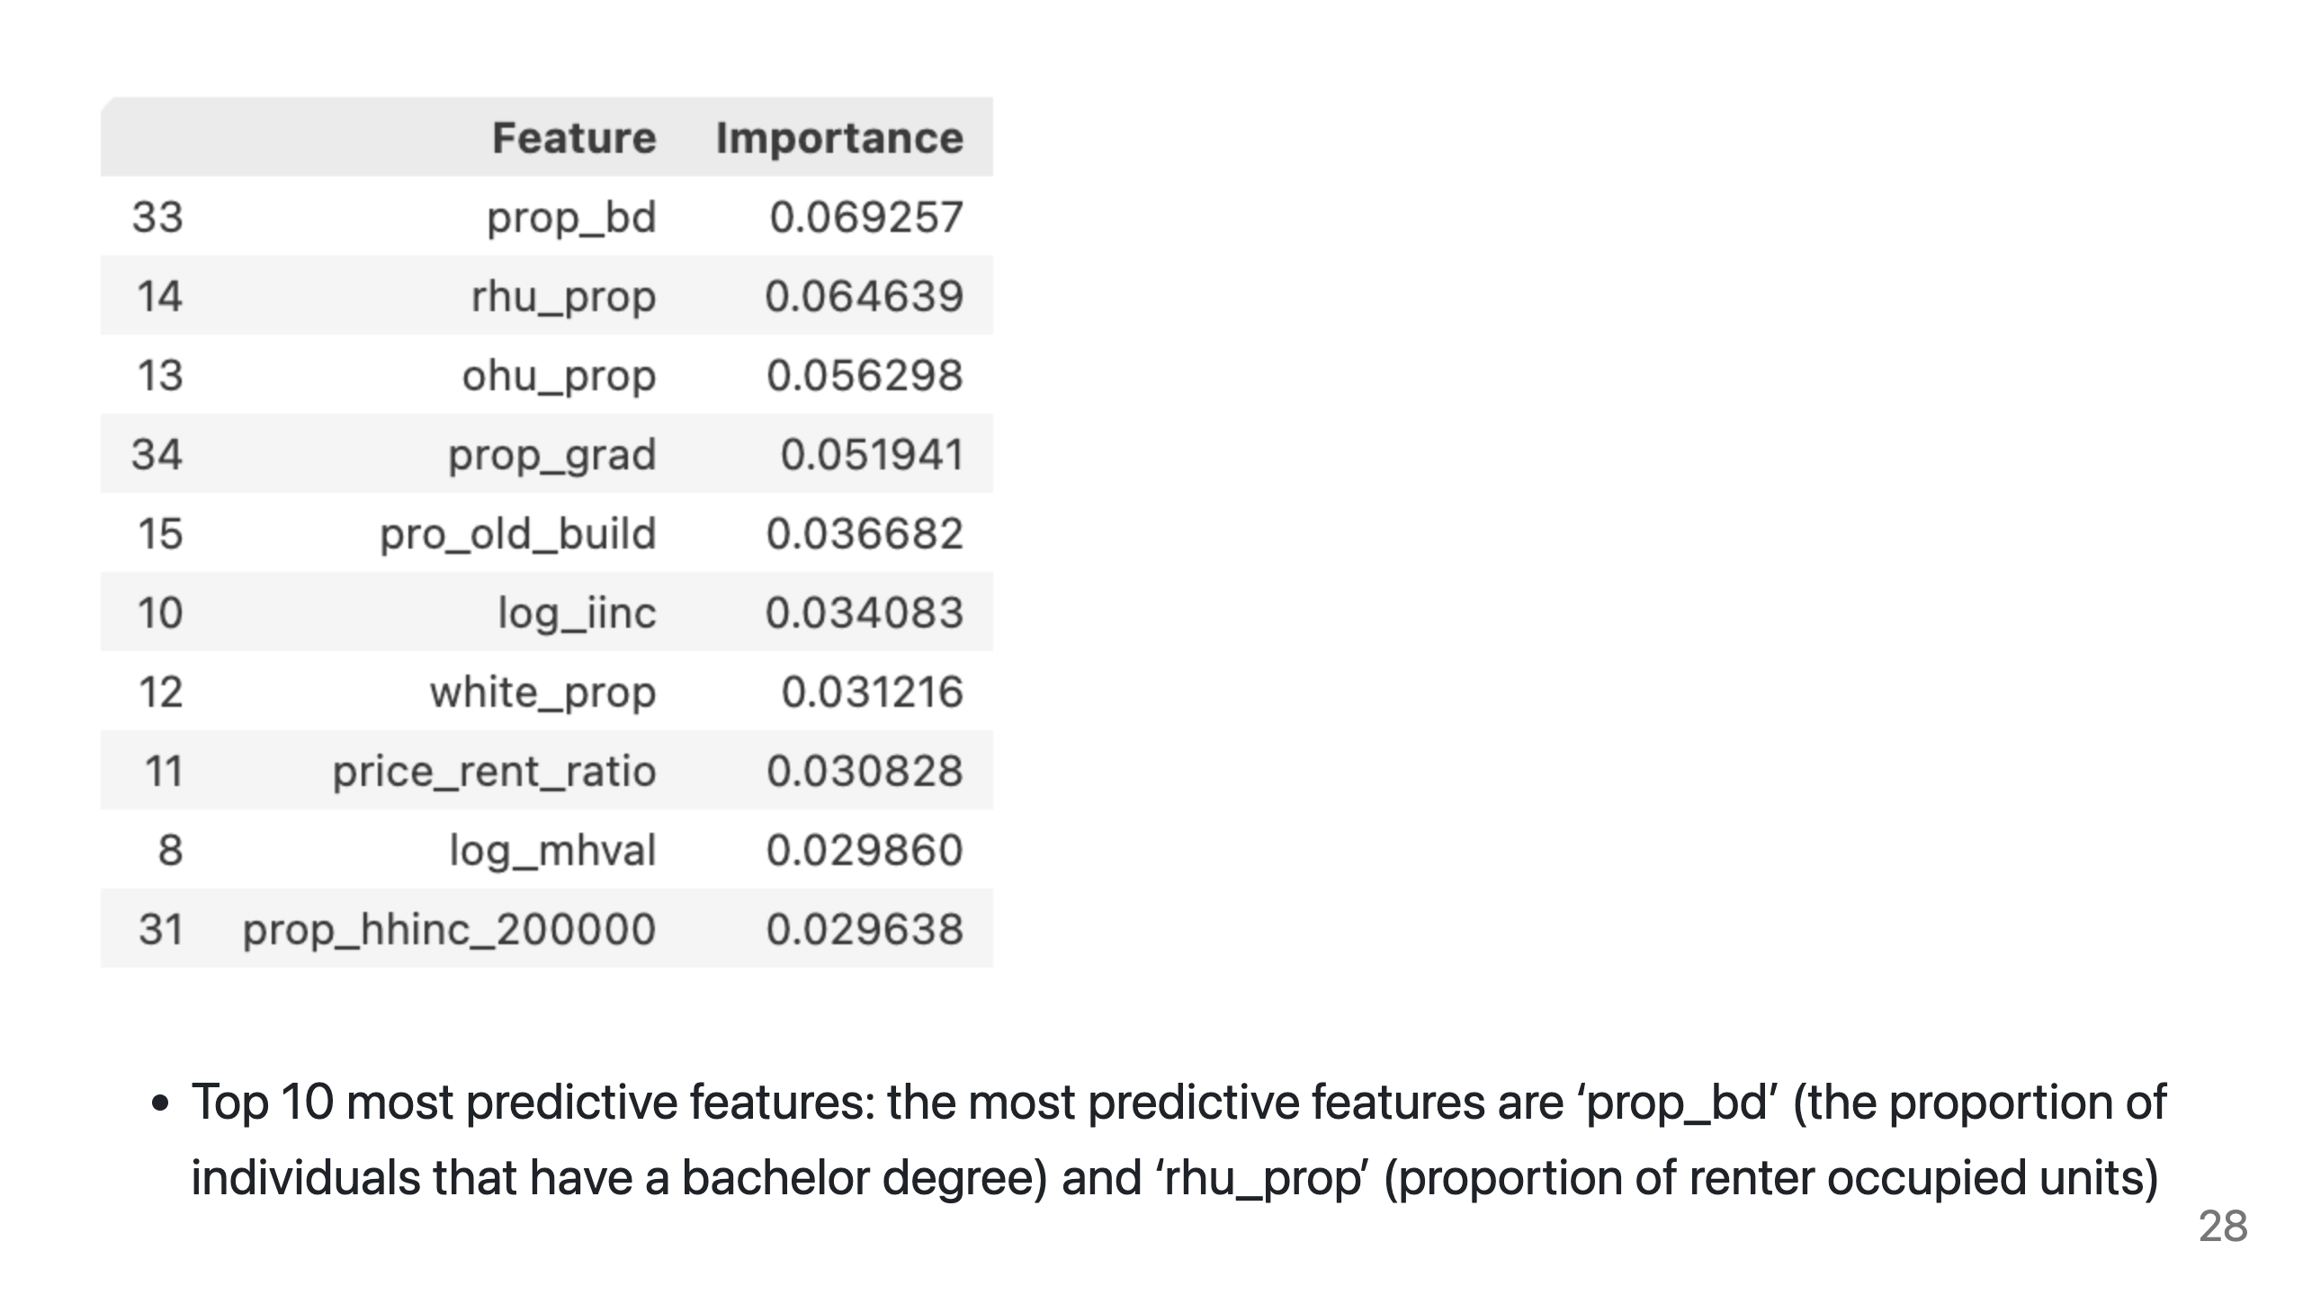
Notes:
The most predictive features were education levels (proportion with bachelor's degrees) and housing characteristics (proportion of renter-occupied units).

Slide 29
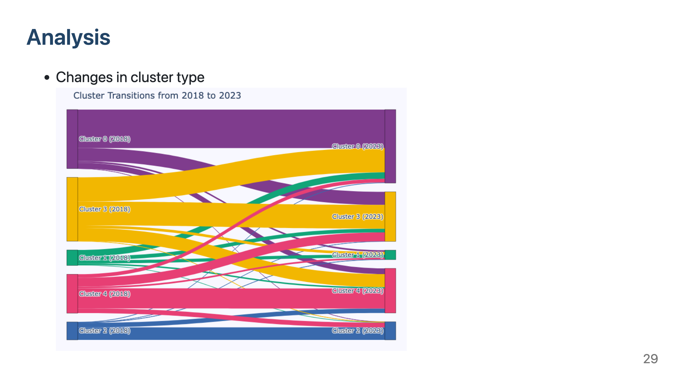
Notes:
Finally, I will provide some additional analysis. Looking at changes of inflow migration pattern for a given census tract between 2018 and 2023, we can see that some tracts appear to be more stable, whose inflow migration type did not change.
A lot of tracts changed from cluster 3 to 0, which suggests decreasing inflow.

Slide 30
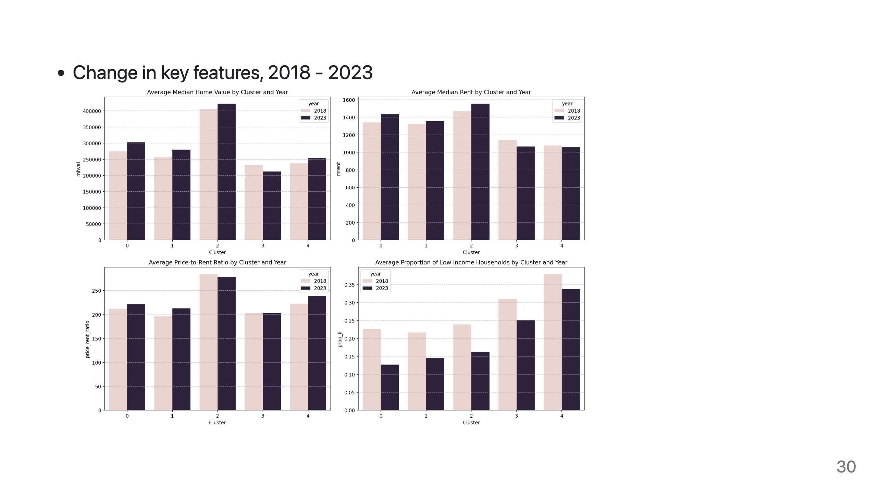
Notes:
For this graph showing key feature changes, we can see that Cluster 2 stands out with highest home values and rents , suggesting premium neighborhoods;
Most clusters show increased home values except Cluster 3, which declined.

Slide 31
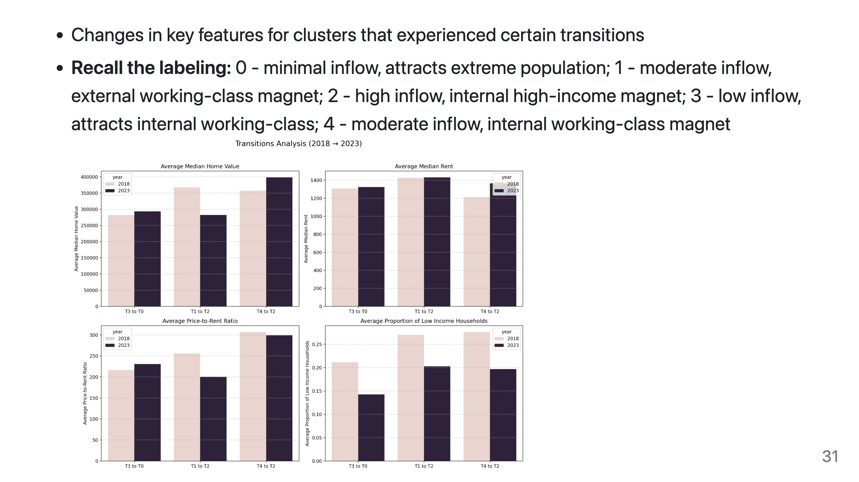
Notes:
For this graph that represents tracts that experience certain transitions:
Areas transitioning from Cluster 3→0 saw moderate home value increases but decreasing low-income representation
(Neighborhoods shifting from Cluster 1→2 maintained high home values but saw substantial low-income population decrease)
Thos shifting from Cluster 4→2 shows highest home value increase coupled with significant decline in low-income households

Slide 32
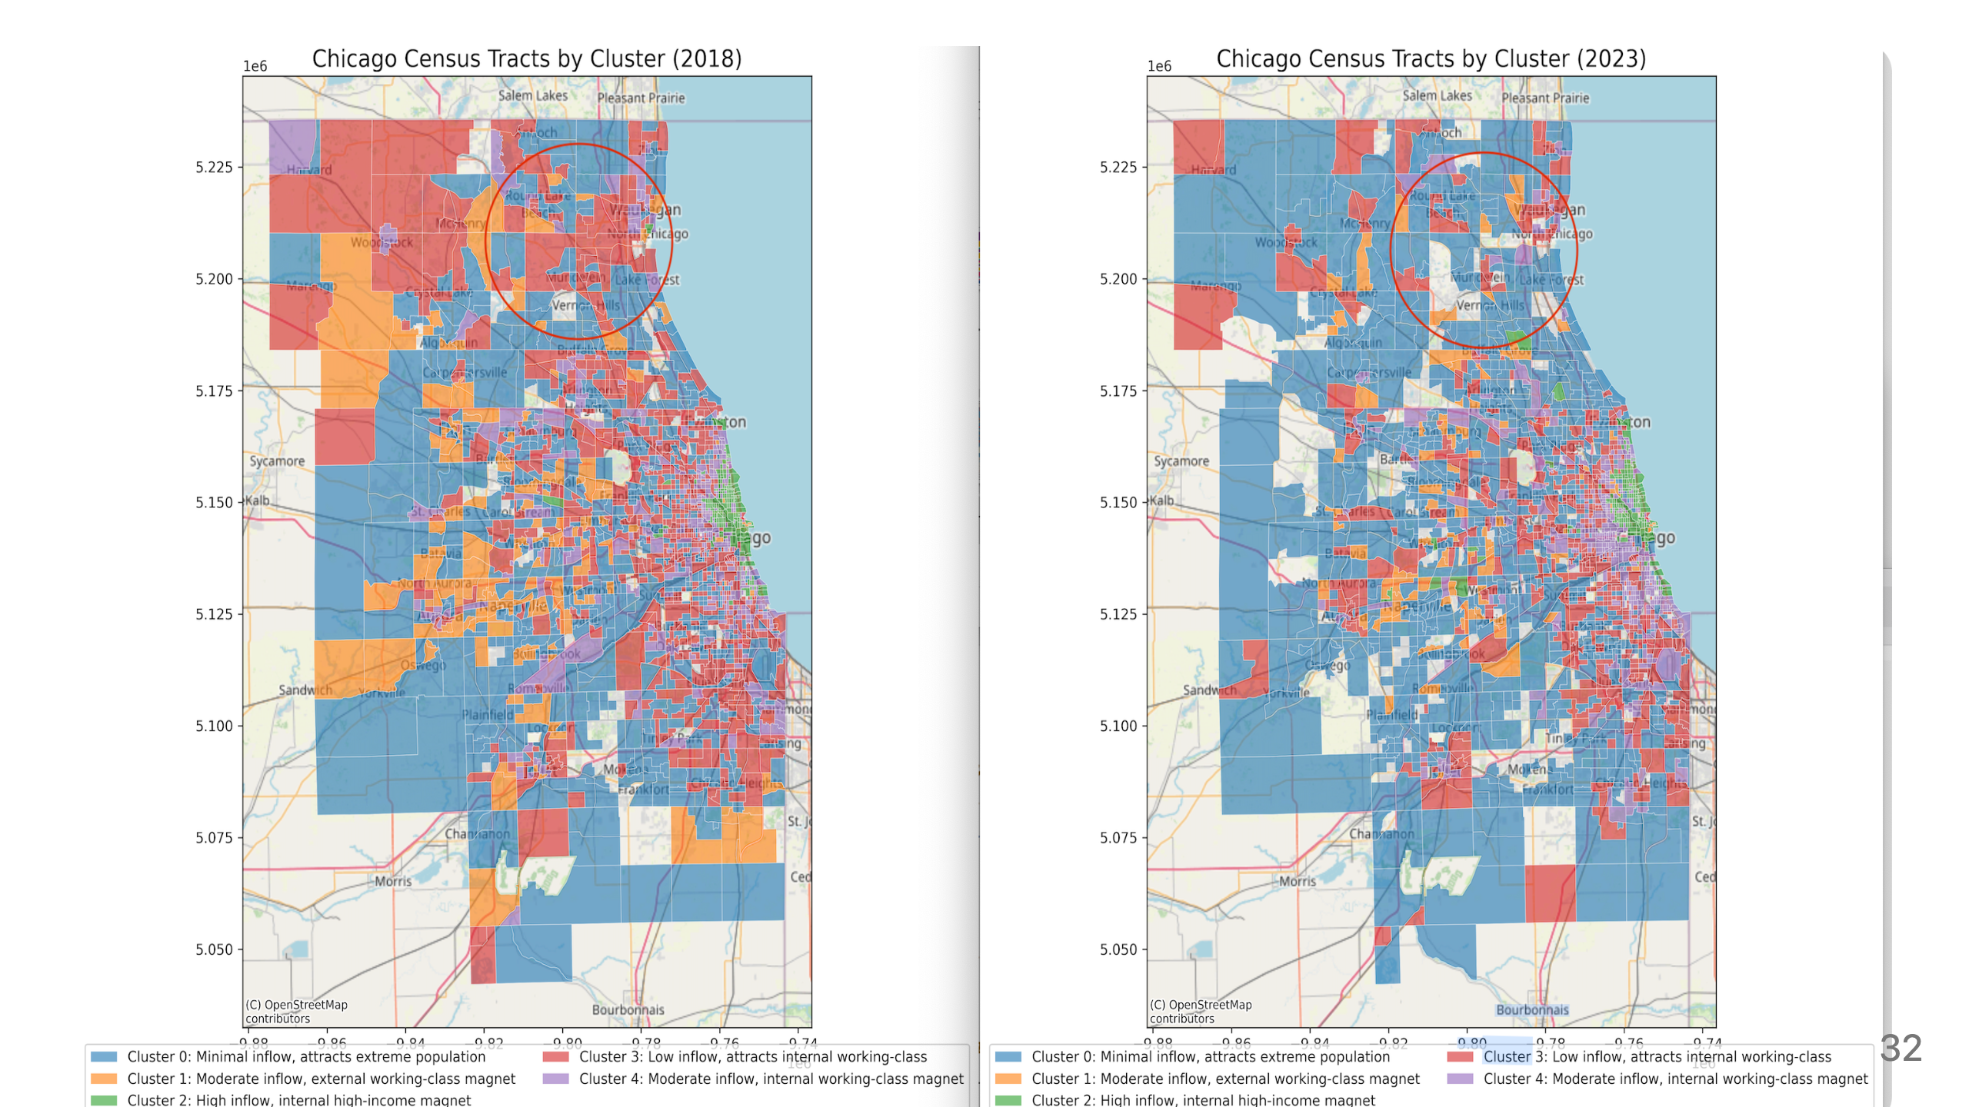
Notes:
This map comparison shows that many areas transitioned from places with low inflow of working-class households to places with minimal inflow (migration deserts).
All these patterns suggest gentrification processes, particularly for areas transitioning to Cluster 2 (high-income magnets), where displacement of low-income residents occurring alongside property value increases.

Slide 33
